Slide 1
Evolution of China’s Industrial Spatial Layout (1987 – 2017)
-- Based on Regional Input-Output Tables
Shantong Li; Jianwu He; Yi Huang
Development Research Center of The State Council
Development Strategy and Regional Economic Research Department
Note：This report only represents the views of the authors and does not represent the views of the institution where they belong.

Slide 2
Contents
Background
Model and Data
Shift of China’s economic gravity centers
Shift of China's three industries gravity centers
Shift of China's secondary industry gravity centers

Slide 3
Background
The spatial layout of industries is a key issue for the coordinated regional development in China, and it is related to the overall situation of the country's economy, society, environment and security.
Reasonable industrial spatial layout can fully take advantage of different regions and promote coordinated regional development；
The basic logic of the evolution of the industrial layout and spatial structure in China is as follows:

Slide 4
Background
Use the gravity center model to study the significance of industrial spatial layout
The shift of the industrial gravity centers reflects the evolution and equilibrium degree of China's regional economic development and industrial development, thereby it can help us to reveal the relationship and laws between industrial development and economic development;
Through the analysis of the industrial gravity centers and economic gravity centers, we can deeply grasp the changes in the equilibrium of China's regional development;
It can provide comprehensive and overall information of the industrial spatial layout to decision makers as the good reference for industrial policy and regional policy.

Slide 5
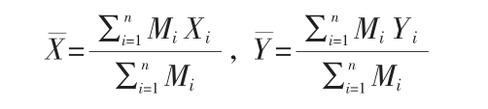
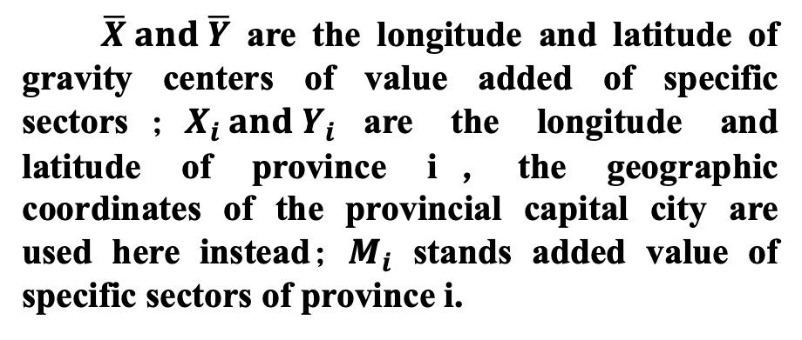
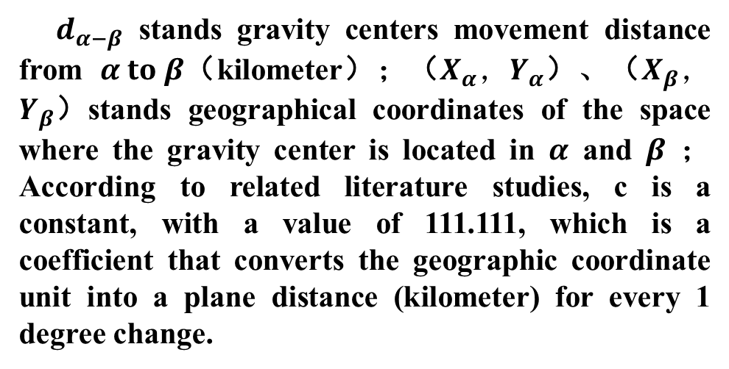

Model and Data
The Gravity Center Model
$$d_{α−β}=c·\sqrt{{\left(X_{α}−X_{β}\right)}^{2}+{\left(Y_{α}−Y_{β}\right)}^{2}}$$
$\overline{X} and \overline{Y}$ are the longitude and latitude of gravity centers of value added of specific sectors$；X_{i} and Y_{i}$are the longitude and latitude of province i，the geographic coordinates of the provincial capital city are used here instead$；M_{i}$ stands added value of specific sectors of province i.
$d_{α−β}$ stands gravity centers movement distance from $α to β$（kilometer）；（$X_{α}，Y_{α}$）、（$X_{β}，Y_{β}$）stands geographical coordinates of the space where the gravity center is located in $α$ and $β$ ； According to related literature studies, c is a constant, with a value of 111.111, which is a coefficient that converts the geographic coordinate unit into a plane distance (kilometer) for every 1 degree change.

Slide 6
Model and Data
Data source
China’s Regional Input-Output Tables from 1987 to 2017.
  The regional input-output table can directly reflect the relationship between production technology and the comprehensive balance of supply and demand among various sectors in the region；
  To provide comparable multi-sectoral data for a long period (30 years).
GDP and Value-added data of the three industries of National Bureau of Statistics from 1992 to 2019 and Compilation of 60 Years of New China from 1980 to 1991, which prove the rationality of using the regional input-output table to study gravity centers shift.
All spatial geographic data comes from the National Basic Geographic Information System 1:4 million database, covering the latitude and longitude coordinates of the administrative division maps and geographic centers of gravity. For the convenience of calculation, it is assumed that the latitude and longitude coordinates of the provinces are represented by the latitude and longitude coordinates of the provincial capital city.

Slide 7
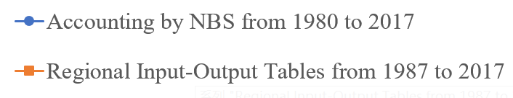
Shift of China’s Economic Gravity Centers
Period | Moving direction
1987-1992 | South and West
1992-2002 | East and South
2002-2012 | West
2012-2017 | South and West

Slide 8
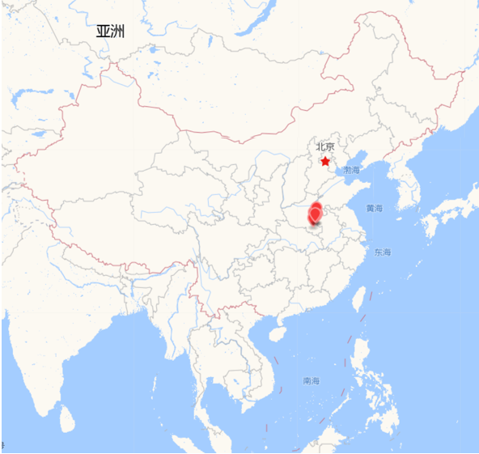
Shift of China’s Economic Gravity Centers
The trajectory of China's economic gravity centers have been moving in southern Henan Province, China.

Slide 9
Shift of China's three industries gravity centers
The primary industry | Moving direction
1987-1992 | South and West
1992-2002 | North and East
2002-2012 | North and West
2012-2017 | West and South
The gravity centers of the primary industry were located on the west side of China's economic gravity centers, shifting to the direction of southwest, with a smaller degree of movement. In 2017, compared with 1987, the gravity centers moved only 0.8 longitude to the west and 0.1 latitude to the south.

Slide 10
Shift of China's three industries gravity centers
The secondary industry | Moving direction
1987-1992 | South and West
1992-2002 | South and East
2002-2012 | West
2012-2017 | South and West
The gravity centers of the secondary industry were located to the east side of China’s economic gravity centers, shifting to the southwest, with the largest degree of movement.

Slide 11
Shift of China's three industries gravity centers
The tertiary industry | Moving direction
1987-1992 | South and West
1992-2002 | East and South
2002-2012 | West
2012-2017 | South and West
The tertiary industry was highly consistent with the movement trajectory of China's economic gravity centers. The overall movement was to the southwest with a relatively large movement and the trajectory lied between the primary industry and the secondary industry.

Slide 12
Shift of China's three industries gravity centers
The secondary industry plays a very important role in the shift of China’s economic gravity centers. The contribution rates of the secondary industry’s gravity centers were over 46% between 1987 and 1992, and they rose to over 47% between 1992 and 2002. By 2002-2012 Between them reached more than 51%, regardless of the longitude direction or the latitude direction, the contribution of the secondary industry is the first. It was not until the rapid development of the tertiary industry from 2012 to 2017 that it became the main force.

Slide 13
Shift of China's secondary industry gravity centers
Mining industry（Resource-intensive industries）
Stable in the middle reaches of the Yellow River in northern China
Natural resources
Policy
Dependence of Foreign trade
Coal Mining Industry Oil and Gas Extraction Industry
Metal Mining Industry Non-metallic Mining Industry

Slide 14
Shift of China's secondary industry gravity centers
Manufacture industry (according to factor intensity)
Classification | Period | Moving direction
Labor-intensive | 1987-1992 | South and West
 | 1992-1997 | South and East
 | 1997-2002 | East and North
 | 2002-2007 | West and South
 | 2007-2012 | West and North
 | 2012-2017 | West and South
Capital- intensive | 1987-1992 | West and South
 | 1992-1997 | South and West
 | 1997-2002 | West and South
 | 2002-2007 | West and North
 | 2007-2012 | West and South
 | 2012-2017 | West and South
Technology-intensive | 1987-1992 | South and West
 | 1992-1997 | South and East
 | 1997-2002 | South and East
 | 2002-2007 | South and East
 | 2007-2012 | West
 | 2012-2017 | West and South

Slide 15
Shift of China's secondary industry gravity centers
The trajectory of gravity centers of various manufacture sectors from 1987 to 2017
Food manufacturing and tobacco processing industry
Textile industry
Clothing, leather, down and its products industry
Wood processing and furniture manufacturing
Papermaking, printing and cultural and educational supplies manufacturing
Other manufacturing
Petroleum processing, coking and nuclear fuel processing industry
Chemical industry
Non-metallic mineral products industry
Metal smelting and rolling processing industry
Metal products industry
General and special equipment manufacturing industry
Transportation equipment manufacturing
Electrical machinery and equipment manufacturing
Communication equipment, computer and other electronic equipment manufacturing
Instruments and meters, cultural and office machinery manufacturing

Slide 16
Shift of China's secondary industry gravity centers
Labor-intensive manufacturing
China's labor-intensive industries are mainly concentrated in the eastern coastal areas. Among them, “Clothing, leather, down and its products industry" and " Textile industry" are highly concentrated. In contrast, “Food manufacturing and tobacco processing industry" has the most even distribution.

Slide 17
Shift of China's secondary industry gravity centers
Labor-intensive manufacture sectors

Slide 18
Shift of China's secondary industry gravity centers
Labor-intensive manufacturing
"Food manufacturing and tobacco processing industry" is closely related to the development of agriculture. The processing and manufacturing of various foods cannot be separated from the use of agricultural products as raw materials. The shift of gravity centers is relatively small and the industrial distribution is relatively even.
The trajectory of the overall gravity centers of the " Textile industry" moved toward the direction of southeast, and the shift to the south was larger and the moving speed was slower. After China joined WTO in 2001, the geographical advantages of coastal areas have prompted labor-intensive industries to gather in coastal areas. In recent years, as labor costs have risen, the textile industry has gradually deviated from the traditional manual-dependent production method and turned more into machinery. With the increase in mechanization, the increase in labor productivity has led to a decline in the proportion of labor costs in production costs. In 2017, the export dependence of this sector has reached 51.2%, and a large number of exports have also driven the textile industry's gravity centers to move toward the direction of southeast.

Slide 19
Shift of China's secondary industry gravity centers shift
Labor-intensive manufacture sectors
The overall gravity centers of “Clothing, leather, down and its products industry" moved toward the direction of southeast, and the moving range was greater than that of the "textile industry", indicating that the clothing industry in the eastern coastal areas was more prosperous. This sector was still a traditional labor-intensive industry and relied on a large number of labors gathered in the eastern region. At the same time, with the deepening of globalization, foreign investment and exports, coupled with the operation and promotion of brands, the export dependence of this sector reached 41.7% in 2017. The export-oriented industrial characteristics and the geographical advantage of the eastern coastal area have attracted a large amount of foreign investment to participate in international trade actively, which promoted the continuous shift of the department toward the direction of southeast.

Slide 20
Shift of China's secondary industry gravity centers
Capital-intensive manufacturing
Compared with other manufacturing sectors, China's capital-intensive manufacturing is located in the north, and the overall trend is shifting from east to west. Except for “Metal products industry" which has increased in agglomeration since 2007, other sectors are evenly distributed. There is a strong correlation between the spatial distribution of this type of manufacturing sector and the distribution of resources. Among them, “Petroleum processing, coking and nuclear fuel processing industry" is mainly distributed in large oilfields. The trajectory of gravity centers has a large range of movement, spanning 3.44 longitudes and 2.55 latitudes, and the moving speed is extremely fast.

Slide 21
Shift of China's secondary industry gravity centers
Capital-intensive manufacturing

Slide 22
Shift of China's secondary industry gravity centers
Capital-intensive manufacturing
According to traditional resource endowment factors, the geographical distribution of resource-intensive industries depends on resource endowment. In order to minimize transportation costs, most resource-intensive industries are concentrated in raw material production areas. However, due to the influence of circular causality, the industrial layout caused by historical accidental factors may bring about "path dependence.“ In China, due to a large number of resource-intensive industries such as oil and steel in the central and western inland areas during the “Third-line" construction period, the historical pattern of resource-intensive industries has been formed, which determines the layout of China's resource-intensive industries.

Slide 23
Shift of China's secondary industry gravity centers
Capital-intensive manufacturing
After China’s accession to WTO, industrial structure has changed. It has shifted from serving domestic market to international markets. It has become increasingly dependent on international markets. The dependence on imports of raw materials such as oil, natural gas, and metal ores has increased. In addition, development of urbanization and convenience of transportation conditions have also promoted the development of the iron and steel industry and industrial layout tends to be scattered.
As China's status in globalization continues to improve, China's resource-based products must not only meet domestic needs, but also provide a large number of services for international markets. Government policy support is particularly important for development of resource-intensive industries. Coastal opening policies and industrial encouragement policies have guided Guangxi, Guangdong and other coastal areas to invest heavily, build large-scale and high-quality steel, oil refining, and petrochemical enterprises, and guide the transfer of resource-intensive industries.

Slide 24
Shift of China's secondary industry gravity centers
Technology-intensive manufacturing
From 1987 to 2017, the technology-intensive manufacturing sectors were concentrated in the eastern coastal areas, and the overall trend was shifting from north to south. Except for the "instrument, culture, and office machinery manufacturing industries" that moved toward the direction of southeast, all other industries moved toward the direction of southwest, and this type of manufacturing all showed an "S"-shaped change curve, that is, first shifted to the southeast, and then moved toward the direction of southwest. Among them, the " Instruments and meters, cultural and office machinery manufacturing " and "manufacturing of communication equipment, computers and other electronic equipment" moved at a faster speed with a bigger degree of movement .

Slide 25
Shift of China's secondary industry gravity centers
Technology-intensive manufacturing
The picture on the left shows the industrial concentration of technology-intensive manufacturing sectors in the east, central, west and northeast from 1987 to 2017.

Slide 26
Shift of China's secondary industry gravity centers
Technology-intensive manufacturing
Technology-intensive industries are important strategic industries of the country, which are related to improvement of country's technological level and industrial competitiveness. Different types of technology-intensive industries are at different stages of the industrial life cycle, which will lead to differences in the spatial layout of the industry. In particular, industries in the innovation period will be more likely to gather in a certain area to resist risks and when the industry matures, it will Spread to areas with lower labor costs.

Slide 27
Shift of China's secondary industry gravity centers
Technology-intensive manufacturing
"Communication equipment, computer and other electronic equipment manufacturing" is a highly geographically concentrated industry. From 2012 to 2017, the gravity centers quickly moved toward the direction of southwest, indicating that this industry has developed rapidly in recent years and has gradually matured. The coastal areas have shifted to the central and western regions. In addition, the use of chips, machine tools and other advanced equipments in technology-intensive industries are heavily dependent on imports. In 2017, import dependence of the sector reached 57.7% and export dependence reached 32.3%, which prompted the sector to move toward the direction of southwest to a certain extent .
"Instruments and meters, cultural and office machinery manufacturing" is also a highly geographically concentrated industry. Unlike other technology-intensive manufacturing industries, the gravity centers shifted to southeast from 2012 to 2017 and the degree of concentration increased. It shows that the industry is still in the fast-growing innovation stage, which depends on the R&D capabilities and foreign investment level of coastal areas.

Slide 28
Thanks！

