Slide 1




Input-output models and ecosystem service feedbacks:
Estimating the net GVA of economies
Emily Stebbings
I-O Workshop, Osnabrück
31st March 2017

Slide 2
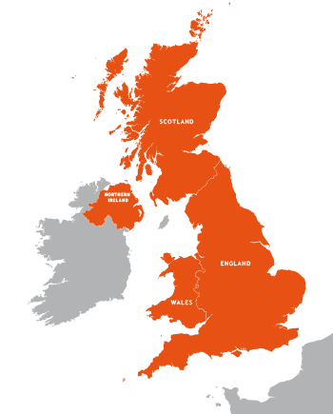

Introduction
1st year PhD student at Plymouth Marine Laboratory and the University of Exeter.
Supervisory team
Eleni Papathanasopoulou (PML)
Xiaoyu Yan (University of Exeter)
Tara Hooper (PML)
Mel Austen (PML)
Plymouthproperty.co.uk

Slide 3
Introduction
Ecosystem services and marine spatial planning
Intended aims and impacts
Developing the methodology
Illustrative results
Challenges

Slide 4
What are ecosystem services?
Ecosystem services are the goods and benefits that people get from the natural environment.
Provisioning - such as food, water and energy
Cultural - such as recreational or spiritual benefit
Regulation & maintenance – such as gas exchange, disease control, climate regulation
Defined end user products → no double counting
CICES V4.3 (Haines-Young & Potschin, 2010; 2013)

Slide 5
Why ‘value’ the ecosystem?
The first step towards sustainable management.
The UK Marine Policy Statement indicates that ecosystem service approaches should be used for decision making, and wider socio-economic impacts should be considered (HM Government, 2011).
Move towards natural capital accounting in UK.
Ecosystem contributes to economic performance (Anger et al. UK NEA WP2, 2014).

Slide 6

Why ‘value’ the ecosystem?
UK NEA Follow-on, 2014
Research to develop and test methods to assess links between economy and ecosystem should be a priority.
I-O and Econometric I-O identified as a likely approach.

Slide 7
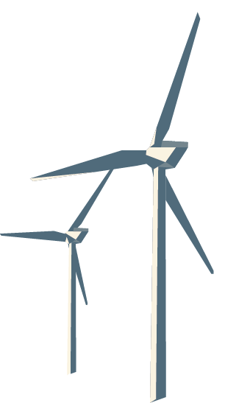
Aims and impacts
Develop a model which incorporates ecosystem services into the macro-economy.
Apply to offshore wind energy to assess net economic impact.
Inform decision making.
Provide socio-economic evidence for UK Marine Management Organisation’s marine plans.

Slide 8
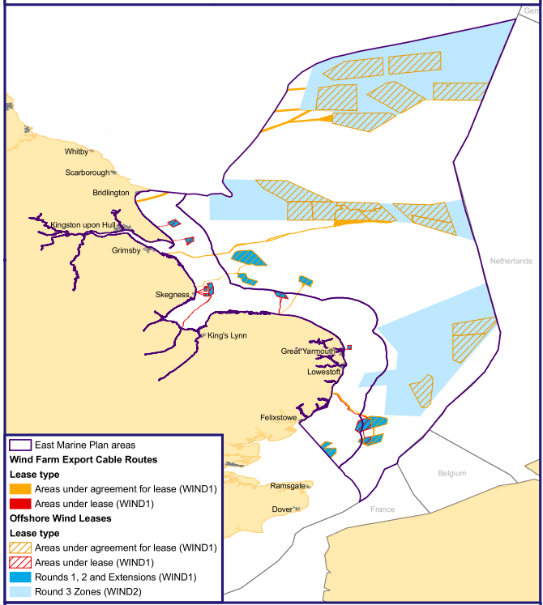
Marine spatial planning
(Marine Management Organisation, 2014)
© Crown copyright 2013

Slide 9
Research questions
Can Input-Output analysis be applied in the marine environment to give an appropriate measure of net economic impact?
What effects do feedback loops of interconnected ‘providers’ of ecosystem service have upon one another?

Slide 10
I-O models and the ecosystem
I-O research that has been influential;
Impact study into development of offshore renewables (Fraser of Allander Institute, 2014).
Biodiversity impacts on global forest ecosystems (Lenzen et al., 2012).
Sustainable coastal zone management in France (Cordier et al., 2011; 2014).
I-O application to oyster farming in Taiwan (Chen et al. 2013)

Slide 11
Model assumptions
All the usual market assumptions pertaining to Leontief I-O tables apply. Additional assumptions;
The GVA of the aggregate sectors to which each ecosystem service is a part will increase or decrease linearly. There is no product substitution effect.
Effects are estimated in the short term, i.e. lag effects or sector growth are ignored.
Non-market and government sectors are excluded.

Slide 12
UK Input-Output tables
Non-market: Governmental and NPISH (Non-profit institutions serving households)
e.g.
Health services
Education
Creative arts
Museums
10 x 10 dimension,
market sectors only
Produced using UK Input-Output Analytical Tables 2010 (ONS, 2011)

Slide 13
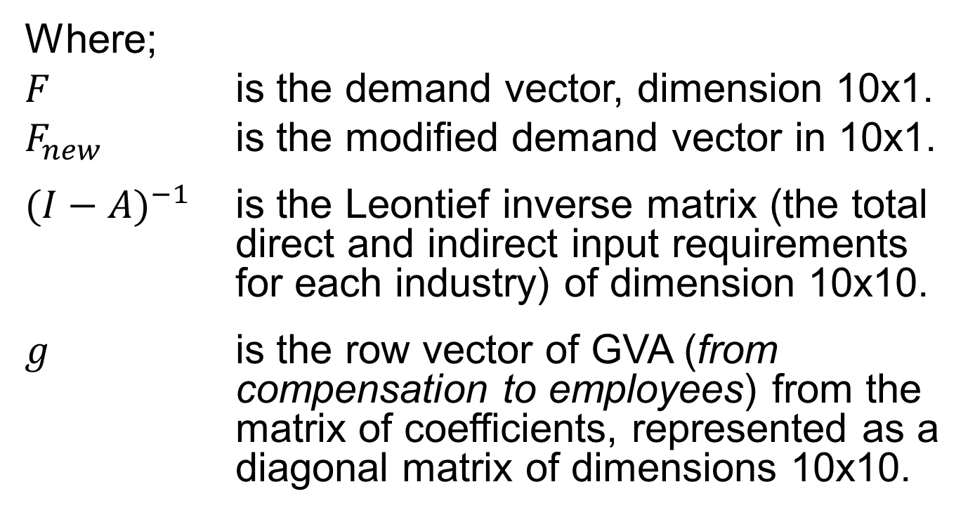

Input-Output
$$∆ GVA= \text{g} {(I−A)}^{−1} {(F−F}_{new})$$
Where;
$F$ is the demand vector, dimension 10x1.
$F_{new}$ is the modified demand vector in 10x1.
${(I−A)}^{−1}$ is the Leontief inverse matrix (the total direct and indirect input requirements for each industry) of dimension 10x10.
$g$ is the row vector of GVA (from compensation to employees) from the matrix of coefficients, represented as a diagonal matrix of dimensions 10x10.
Notes:
OECD: Gross value added at basic prices used to calculate the output-approach GDP is equal
to the sum of: “Compensation of employees” plus “Gross operating surplus and mixed income”, plus “Other taxes
on production”, net of subsidies. These “other” taxes and subsidies should not be confused with taxes and subsidies on products.

Slide 14
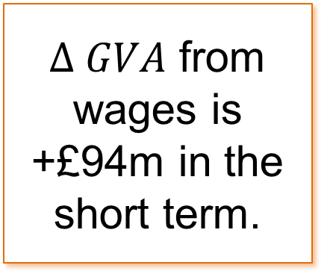


Wages as measure of $∆ GVA$
Offshore wind energy
$$∆ GVA= \text{g} {(I−A)}^{−1} {(F−F}_{new})$$
$∆ GVA$ from wages is +£94m in the short term.
Sense check to other studies – Fraser of Allander Institute ORE

Slide 15
Industry split and disaggregation
Percentage of Input-Output final demand contributed by selected ecosystem services to high level I-O product
I-O Product | Ecosystem service | % of final demand | Source
Production | Offshore wind energy | 0.09% | ONS detailed table (2011)
Agriculture | Fisheries & aquaculture | 8% | ONS detailed table (2011)
Other services | Marine recreation | 5% | ONS report for the MMO (2014)
Produced using UK Input-Output Analytical Tables 2010 (ONS, 2011)

Slide 16
Evidence for ecosystem effects
Fisheries | Large fishing vessels unable to access areas surrounding turbines. Change in fishers’ behaviour.
Aquaculture | Turbine structure provides favourable environment for shellfish such as mussels. Aquaculture sector identified as a way to mitigate the loss of fishing opportunities.
Recreation | Aesthetic and recreational value reduced by presence of turbines.
(Gray, Stromberg, & Rodmell, 2016; Andersson & Öhman, 2010; Papathanasopoulou et al., 2015)

Slide 17

Modified demand $F_{new}$
Percentage change in final demand caused by offshore wind sector to selected ecosystem services surrounding development
Ecosystem service | Sector change
Offshore wind energy | +100%
Fisheries | -5%
Aquaculture | +8%
Marine recreation | -10%
(Gray, Stromberg, & Rodmell, 2016; Andersson & Öhman, 2010; Papathanasopoulou et al., 2015)

Slide 18
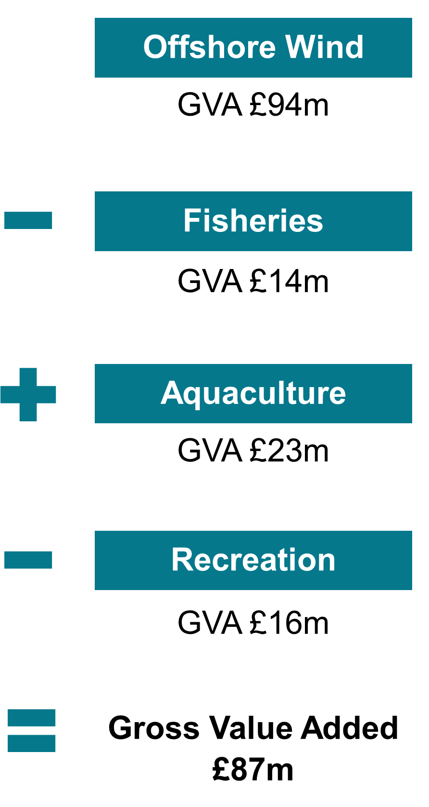
Net economic effect

Slide 19
Challenges
The model assumptions
If a market for the ecosystem service doesn’t exist or can’t be identified, can it be valued?
How should market growth be included, and what will be the longer term effects?
How should non-market economic sectors be treated?
Should a technical coefficients matrix be included?

Slide 20
Challenges
The use of economic data
How can the apportionment, suppression and disaggregation issues be overcome?
  Split geographically or by ecosystem, e.g. between those in the ocean and on land?
  Split economic products, e.g. renewable electricity or hydrocarbon energy sources
  Split industrial sectors, e.g. oceanic or freshwater recreational fishing?
Report by ONS - suggest use of Annual Business Survey, and aGVA. Study to determine economic baseline has taken place.

Slide 21
Challenges
The model application
How can the feedback coefficients for ecosystem services be calculated in order to compute the model?
Is GVA appropriate for this kind of analysis?
Should the Leontief Inverse be dynamic so that a sensitivity analysis can later be carried out?
Potential solutions to many of these issues might be to use an econometric I-O.

Slide 22
Next steps
Resolve the issues or address challenges
Systematic review for ecological evidence
Scenarios – using UK NEA outlooks
Causation or correlation – magnitude of economic impacts

Slide 23

Questions?
Thanks for listening!
emst@pml.ac.uk
@e_stebb

Slide 24
Acknowledgements
With thanks to the NERC GW4+ DTP and the Marine Management Organisation.
This work was supported by the Natural Environment Research Council [NE/L002434/1].
All graphics author’s own, except where stated.

Slide 25
Bibliography
Andersson, M. H., & Öhman, M. C. (2010). Fish and sessile assemblages associated with wind-turbine constructions in the Baltic Sea. Marine and Freshwater Research, 61(6), 642–650. https://doi.org/10.1071/MF09117
Allan, G., Hanley, N. D., McGregor, P. G., Swales, J. K., & Turner, K. (2004). An extension and application of the Leontief pollution model for waste generation and disposal in Scotland (Discussion Papers In Economics No. 04–05).
Anger, A., Shmelev, S., Morris, J., Zenghelis, D., & Di Maria, C. (2014). Work Package Report 2: Macroeconomic implications of ecosystem service change and management: A scoping study. In UK National Ecosystem Assessment Follow-on.
Cordier, M., Pérez Agúndez, J. A., Connor, M., Rochette, S., & Hecq, W. (2011). Quantification of interdependencies between economic systems and ecosystem services: An input-output model applied to the Seine estuary. Ecological Economics, 70(9), 1660–1671.
Cordier, M., Pérez Agúndez, J. A., Hecq, W., & Hamaide, B. (2014). A guiding framework for ecosystem services monetization in ecological-economic modeling. Ecosystem Services, 8, 86–96.
Gray, M., Stromberg, P., & Rodmell, D. (2016). Changes to fishing practices around the UK as a result of the development of offshore windfarms – Phase 1.
Haines-Young, R., & Potschin, M. (2010). Proposal for a Common International Classification of Ecosystem Goods and Services (CICES).
Haines-Young, R., & Potschin, M. (2013). CICES V4.3 (January 2013). Retrieved from http://cices.eu/resources/
HM Government. (2011). The UK Marine Policy Statement. Retrieved from http://www.official-documents.gov.uk
Lenzen, M., Moran, D., Kanemoto, K., Foran, B., Lobefaro, L., & Geschke, a. (2012). International trade drives biodiversity threats in developing nations. Nature, 486, 109–112. https://doi.org/10.1038/nature11145
Marine Management Organisation. (2014). East Inshore and East Offshore Marine Plans.
Office for National Statistics. (2011). United Kingdom Input-Output Analytical Tables 2010.
Papathanasopoulou, E., Beaumont, N., Hooper, T., Nunes, J., & Queirós, A. M. (2015). Energy systems and their impacts on marine ecosystem services. Renewable and Sustainable Energy Reviews, 52, 917–926.
Turner, K. (2009). The evaluation of National Accounting with Environmental Accounts as a methodology for carrying out a sustainability assessment of the Scottish food and drink sector.

Slide 26
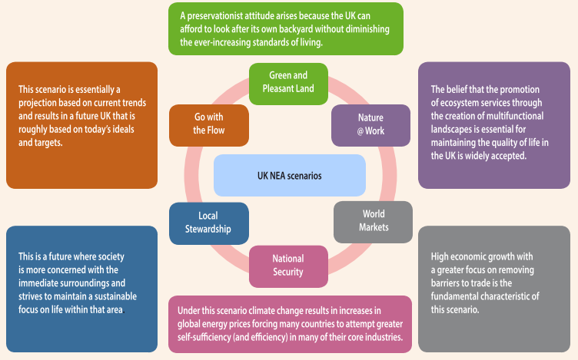
UK NEA scenarios
UK National Ecosystem Assessment Follow-on: Synthesis of the Key Findings (2014)

Slide 27
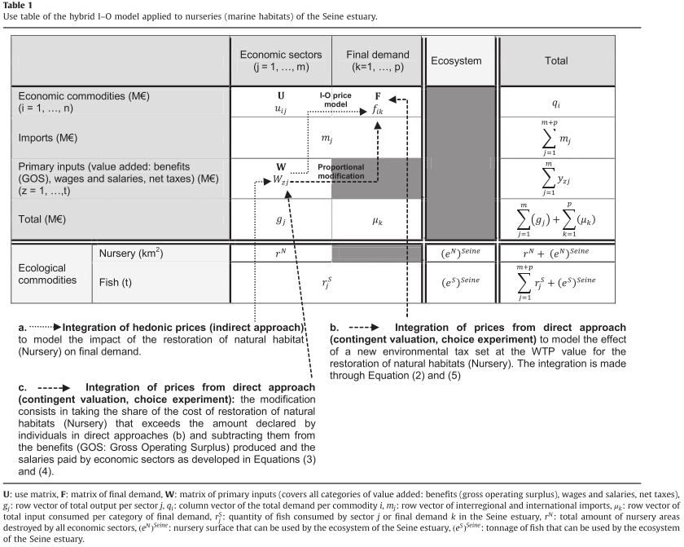
‘Hybrid’ I-O Model: Cordier et al.

