Slide 1



Slide 2
FIGARO
Full International and Global Accounts for Research in Input-Output analysis
The EU Inter-country Supply, Use and Input-Output Tables
José M. Rueda-Cantuche
DG Joint Research Centre
Isabelle Rémond-Tiedrez
Eurostat
Input-Output Workshop Special
Regional/Multiregional Input-Output Analysis
GWS, Osnabrück, March 30-31

Slide 3
Outline
Background
Scope and objectives
Description and organisation
Methodology for the construction of EU IC-SUIOTs
WIOD vs. FIGARO: main features
Integration with global OECD ICIO tables
Next steps

Slide 4
1. Background (1/2)
Convergence of the methods for the construction of ICIO tables is called for in order to support policy making in environment (footprints) and socio-economic applications (GVCs)
Eurostat and DG JRC to develop statistical standards to be recognised by OECD (TiVA), UNSD and WTO on the basis of European Supply, Use and Input-Output tables compiled since 2012.
Experimental EU IC-SUIOTs (2010), ESA2010, BPM6, NACE Rev.2, ISIC Rev.4, CPA/CPC (yearly for IOTs, 5-yearly for SUTs) – by summer 2017 – first version for 2010, later on 2010-2015 for EU28+US+RoW

Slide 5
1. Background (2/2)
Re-use of available data in Eurostat ensuring quality assurance of the EU IC-SUIOTs
FIGARO should serve to create the conditions for sustainable data availability of EU IC-SUIOTs on a continuous basis
The development of the project will be based on:
  Regular combination of global business statistics and macro-economic data sources (TEC, STEC, NAs, etc.)
  Policy needs of the European Commission shall be taken into account
  International perspective with strengthened links to the OECD (TiVA initiative), WTO and UNSD

Slide 6
2. Scope and objectives
Review of methods; collection of user needs (DGs)
Define methodological framework with wide support of producers, users and stakeholders
Integration with Global ICIO tables (OECD)
Links to capital and labour productivity indicators (A10)
Links to environmental accounts (air, material flow, energy)
Extended SUIOTs using global business statistics
Define a long-term Eurostat's strategy (annual; 5-yearly)
The EU IC-SUIOTs aim to be the reference for analysis of trade, globalisation, socio-economic, national accounts and environmental EU policies

Slide 7
3. Description and organisation (1/7)

Slide 8
3. Description and organisation (2/7)
Start: October 2015 – End: December 2017

Slide 9
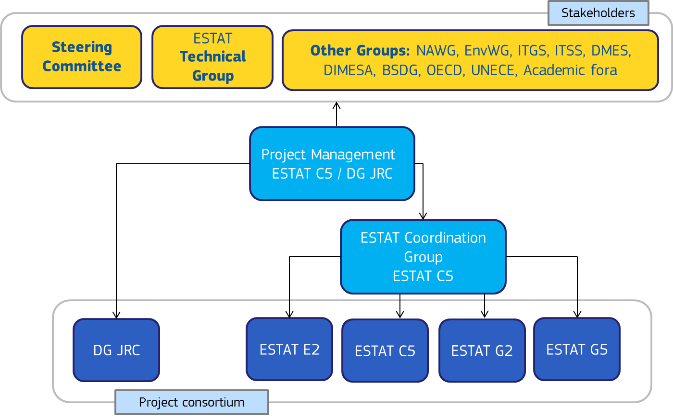
FIGARO reporting structure

Slide 10
3. Description and organisation (4/7)
Based on National Accounts framework
Build up on available data from National Accounts dimension (national SUIOTs) and trade statistics
Standards: ESA 2010, NACE Rev 2 (ISIC 4), CPC/CPA
EU (28 MS) Inter-country SUIOTs + United States
EU part of OECD global ICIO database
Link to labour and capital productivity, environmental accounts and business statistics extensions

Slide 11
3. Description and organisation (5/7)
Data request to trade statisticians
    Trade in goods:
        1995 to 2015
        Exports and mirror imports
        Imports and mirror exports
        Estimated imports and exports
        Reporters: 28 EU MS + US
        Partners: 28 EU MS (+ main partners)
        CN8 - HS-6 digit -> CPA/CPC
Data request to trade statisticians
    Trade in services:
        BPM6 data and mirror data for 2010-2015
        Exports and mirror imports
        Imports and mirror exports
        Reporters: 28 EU MS + US
        Partners: 28 EU MS (+ main partners)
        EBOPs categories

Slide 12
3. Description and organisation (6/7)
More trade data:
  Trade in services from STEC project
    8 EU countries (AT, CZ, DK, EE, IE, LU, NL and PL)
    Year 2011
    BPM5
    Exports, imports
    Partner: intra and extra
    NACE 2 digits and Sections – all services
    NACE section level * services category
  Trade in goods TEC data

Slide 13
3. Description and organisation (7/7)
Memorandum of understanding with OECD
  Update to include Supply, Use and Input-Output data: national
Close collaboration with OECD on methodology
  To ease integration of EU Inter country tables into OECD ICIO
Follow up international initiatives
Workshop Regional TiVA initiatives (March, 2017): Integration with OECD global ICIO tables

Slide 14
4. Methodological framework (FIGARO)
Builds on Ahmad (2017), Fortanier and Sarrazin (2016), Fortanier et al (2016) and Miao and Fortanier (2016) - OECD
  Transparency
  Modularity
  Collaboration and collective ownership
  Long-term horizon
  [Concepts adapted to the EU version]

Slide 15
4. Methodological framework (FIGARO)
Roadmap to FIGARO:
  Preparing national SUIOTs
  Creating a coherent view of EU bilateral trade statistics
  Aligning the balanced view of trade with National Accounts estimates
  Domestic vs. national concepts: Purchases by non-residents and residents' expenditures abroad
  Integrating the balanced view of trade with national SUTs – EU- International SUTs
  The construction of EU-ICIO tables

Slide 16
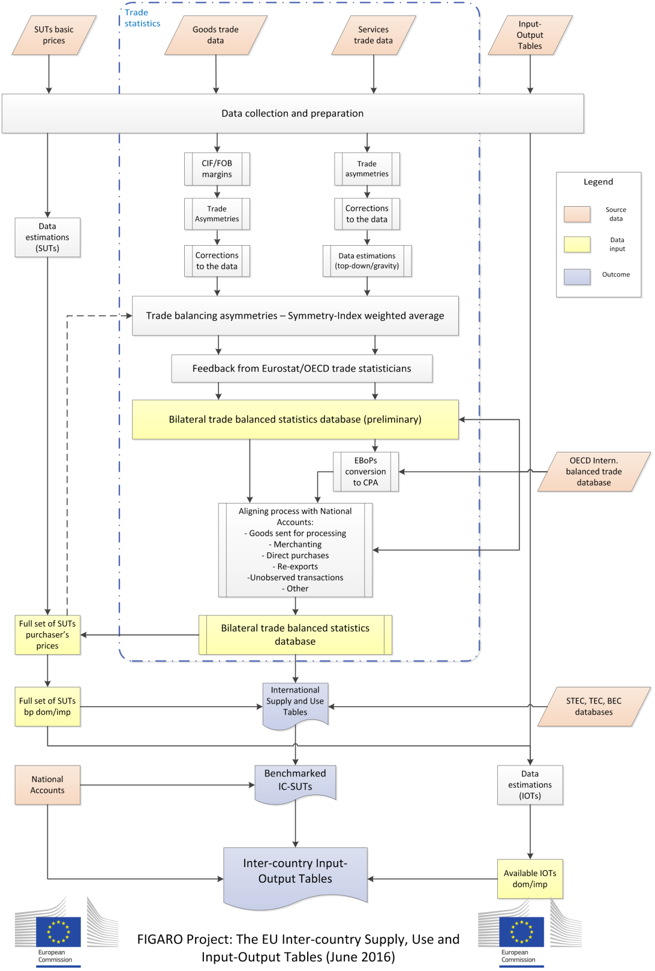

Slide 17
4. Methodological framework (1/10)
  Preparing National SUIOTs:
  National SUTs (pp, bp, dom/imp, A64) - Good practices guidelines, Eurostat and DG JRC (2013) and available official data
  National IOTs (dom/imp, A64) – Models B for product x product IOTs and Model D for industry x industry IOTs; and available official data – but wait until the final stage of constructing ICIO

Slide 18
4. Methodological framework (2/10)
  Creating coherent view of EU bilateral trade:
  Trade in goods (merchandise trade)
    EU COMEXT: Country of consignment/origin
    UN COMTRADE: Country of origin + Re-exports
    OECD-ESTAT integration of extra-EU trade
    Trade asymmetries:
      Reasons: cif/fob; time lag between exp/imp; re-exports; transit trade; unallocated and/or unclassified trade…
      Reconciliation: Symmetry index (weights = % of each country's total trade that approximately match mirror trade flows) + Manual ad-hoc adjustments
      Statistical vs. Analytical tables (Steering Comm. Nov 16)

Slide 19
4. Methodological framework (3/10)
  Creating coherent view of EU bilateral trade:
  CIF/FOB estimations (by product, partner)
    Miao and Fortanier (2017) – explicit model with NSIs estimates and UN COMTRADE;
    FIGARO (2017) – implicit model with COMEXT data 1995-2015 (lack of available data: only FI, DE, SK)
      Gravity model based on: distance; GDP of reporter and partner countries; oil price; insurance costs (median unit value); contiguity; (opt) FE for product, partner and time
      Data sources: COMEXT (imports and exports, EUR/kg – HS-4 digit); CEPII (distance and contiguity); World Bank (GDP p/c); US Energy Information Administration

Slide 20
4. Methodological framework (4/10)
  Trade in services
    Only financial flows observable – modes of supply
    EBOPS items and confidentiality issues
    BPM6-EBOPS2010 and STEC wherever available
    Total Services (S200) complete; gaps in sub-items:
      Top-down approach from: structural info over time; simple derivations; mirror data; linear interpolations; moving averages…
      Gravity models for specific items: Travel services (SD); Use of IPRs (SH); Audio-visual and related services category (SK)
    Trade asymmetries (BOPWG, October 2016) + Index
    Conversion tables EBOPS-> CPA/CPC – RACE method

Slide 21
4. Methodological framework (5/10)
  Aligning with National Accounts
    Sources of differences:
      Unallocated component (coming from the imposibility to allocate specific trade flows to partners and/or products);
      Adjustments to align concepts and coverage between trade statistics and NAs:
        Concepts: goods sent abroad for processing and merchanting activities;
        Coverage: unobserved trade (smuggling, low thresholds…), re-exports and purchases by non-residents in the recording economy

Slide 22
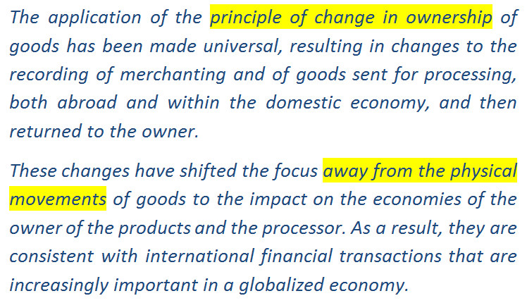
2008 SNA:

Slide 23
Goods sent abroad for processing
Goods
A
B
NA/BoP
services
Money
Source: Nijmeijer (2017)

Slide 24
Goods sent abroad for processing
Goods
A
B
NA/BoP
services
Money
Source: Nijmeijer (2017)

Slide 25
Goods sent abroad for processing
Now in line with domestic processing activities
No imputation of change of ownership
Flows to be excluded from ITGS
Make use of Nature of Transactions codes
Processing service
Preferred source: trade in services survey
Source: Nijmeijer (2017)

Slide 26
Merchanting
B
Goods
A
NA/BoP
goods
Money
C
Source: Nijmeijer (2017)

Slide 27
Merchanting
Change of economic ownership with non-resident
No cross border flows
No physical transformation
Acquisition as negative exports of goods
Sale as positive exports of goods
Preferred source: Enterprise survey of merchants in the compiling economy
Source: Nijmeijer (2017)

Slide 28
4. Methodological framework (6/10)
  Aligning with National Accounts
    Goods sent abroad for processing: not accounted any more as gross exports and gross imports in ESA2010
    Merchanting activities: trade data should reflect merchanting margins applied by the merchanting country included in the amounts paid by importer country
    Re-exports; re-exports should be separated from domestic exports in trade statistics; countries may report only net trade in NAs;
    Unobserved trade; attributed to the difference between:
      Balanced view of trade (incl. adjustments for merchanting)
      SUTs/NAs (incl. changes for re-exports and goods sent abroad for processing)

Slide 29
4. Methodological framework (7/10)
  Aligning with National Accounts
    Unobserved trade; reduce as much as possible this difference by a transparent conversion matrix that reallocates differences across products in a way that it preserves each country's total imports by industry and partner (Ahmad, 2017)
  Discrepancy item
    What remains = "discrepancy item"
    Either leave it aside (statistical approach) or allocating it bi-proporitonally (GRAS) throughout the matrix (analytical approach)
    Comparison of resulting balanced trade with SUTs pp -> Feedback loops, still possible…

Slide 30
4. Methodological framework (8/10)
  Domestic/national concepts in consumption
    Direct purchases abroad by residents (imp) and direct purchases in the domestic territory by non-residents (exp) usually in NAs = lump-sum figure
    Tourism Satellite Accounts + common spending patterns across tourists = used to split balanced view of "travel services" (EBOPS) into "goods" and "pure services" + geographical allocation using balanced view of trade + proportional allocation of remaining difference with NA

Slide 31
4. Methodological framework (9/10)
  Construction of EU International SUTs:
    Trade values of the national SUTs are respected (by industry and reporting country)
    Although later changed possibly due to revision of NAs
    Exports by product and reporter country split across trading partners using balanced bilateral trade data
    Split across users with info from STEC, TEC and import use tables
    Further adjustments to match national imports by industry and reporter country from national SUTs
    SUTs bp available, including TTM and TLS tables (2010)

Slide 32
4. Methodological framework (10/10)
  Construction of EU-ICIO:
    Based on the previously estimated EU International SUTs
      Product by product; final demand components unchanged + Model B (industry technology) + Constrained by official IO tables, wherever available
      Industry by industry; value added components unchanged + Model D (fixed product sales structure) + Constrained by official IO tables, wherever available
    Models B and D must not be applied to the full EU International SUTs

Slide 33
5. WIOD vs FIGARO (1/3)
WIOD update 2005-2014 commissioned by DG ECFIN to RUG/WiiW (Jan - Oct 2016)
Limited duration and human resources compared with the FP7 WIOD Project, leading to differences with respect to FIGARO:
  SUT-RAS or similar countries to estimate missing national SUTs / ESTAT-JRC good practices guidelines (use mainly previous year data)
  WIOD fits perfectly NA data on exports and imports / Trade asymmetries, EU MS NSI, possible corrections of exports and imports values (not net value)

Slide 34
5. WIOD vs FIGARO (2/3)
  No specific treatment of differences in methodologies between NA and (bilateral) trade statistics – use of SUT-RAS/ ESTAT-JRC-OECD study the effects of goods sent for processing, merchanting, re-exports, direct purchases, etc. so to map (to the extent possible) the balanced bilateral trade dataset with NA trade data.
  WIOD splits SNA national import tables (converted in fob values) by country of origin according to the balanced bilateral trade dataset (fitting NA) / FIGARO gives priority to exports (fob) and endogenously estimate national import tables (in fob) by country of origin, respecting total imports by industry & country (cif).

Slide 35
5. WIOD vs FIGARO (3/3)
  WIOD uses BEC and UN COMTRADE for import matrices / FIGARO EU COMEXT, COMTRADE, TEC, STEC data
  WIOD estimates from International SUTs, the full World IO Tables using Model D (industry by industry) / FIGARO would respect official national IOTs and the remanining countries would be estimated from the International SUTs using Model B (product by product) or Model D (industry by industry).

Slide 36
6. Integration with OECD ICIO (1/3)
EU-IC-SUIOTs (IO annual, SUTs 5-yearly): 28 EU Member States
Basic prices
2010
SNA08/ESA10 – BPM6
NACE Rev.2/CPA 08
ISIC Rev.4
64 industries
OECD ICIO (2015): 61 economies – OECD, EU28, G20, most East and South-East Asian economies and some South-Americans
Basic prices
1995,2000,2005,2008-11
SNA93/ESA95 – BPM5
Nace Rev.1.1/CPA2.1/ISIC3
34 industries

Slide 37
6. Integration with OECD ICIO (2/3)
Main changes between SNA93/ESA95 and SNA08/ESA10 affecting the integration of the two databases:
  Treatment of goods sent abroad for processing
  Merchanting activities
  Capitalization of R&D expenses (although less affecting final TiVA results)
  Treatment of construction activities abroad (although less affecting final TiVA results)

Slide 38
6. Integration with OECD ICIO (3/3)
MoU (2016-2020) – Schedule
  2017: Finalize FIGARO EU-IC-SUIOTs (2010) as consistent as possible with the OECD + dissemination/revision strategies + agreement on process and methodology for balanced bilateral trade database
  2018: Full integration for 2010 (FIGARO and OECD-ICIO)
  2019: Construction of anual time series (2011-14)
  2020: Construction of time series (2010-15) + revisions

Slide 39
7. Next steps
Complete the EU methodological framework with support of the OECD
Working meetings with Eurostat's trade statisticians and environmental accountants; and the OECD
Work on balancing bilateral trade data and subsequent steps to compile the first preliminary version of the EU-IC-SUIOT by summer 2017

Slide 40
Thank you for your attention!!
The FIGARO Project
The EU Inter-country Supply, Use
and Input-Output Tables
José M. Rueda-Cantuche
DG Joint Research Centre
Isabelle Rémond-Tiedrez
Eurostat
Input-Output Workshop Special
Regional/Multiregional Input-Output Analysis
GWS, Osnabrück, March 30-31

