Slide 1
Global land-use impacts of EU’s future bioeconomy
An econometric input-output approach
Johannes Többen, Saskia Reuschel, Britta Stöver, Lara Ahmann, Martin Distelkamp, Christian Lutz

Slide 2
Agenda
Motivation: Bioeconomy and Sustainable Development Goals
The Modelling Setup
  GINFORS-E
  Modelling production, consumption and trade of biomass
Scenario Specifications
  General
  Bioeconomy
First results
Outlook

Slide 3


Motivation: Bioeconomy and Sustainable Development Goals
BMBF-Project BEST: What are the EU bioeconomy‘s contributions to and potential trade-offs for global SDGs?
Objectives EU Bioeconomy Strategy:
  Contribution to climate goals
  reducing import dependency
  Jobs and economic competitiveness
4 components of the Bioeconomy:
  More efficient biomass production: Agriculture, Forestry, Fishery/Aquaculture
  Increased use of bioenergy (Transportation, Buildings, Industry)
  Inreased use of biomaterials in traditional applications (Construction)
  New bio-based materials (bio-plastics, platform chemicals)

Slide 4
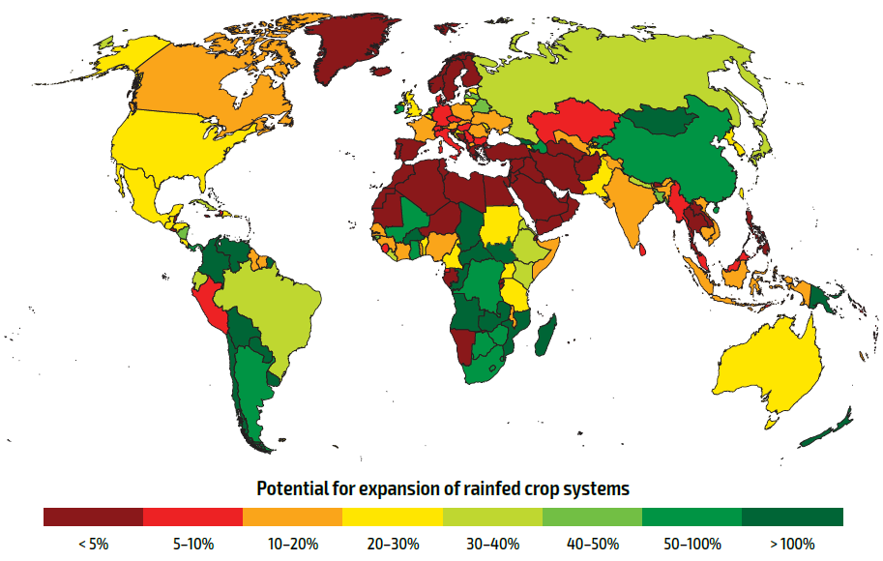
Motivation: Focus on Agriculture and Land use
Availability of arable land main bottleneck for growth of bioeconomy
  Food vs. Fuel
  Risk of future losses of arable land due to climate changes
  Future demand for food and global population growth
Impact on environmental SDGs strongly linked to agricultural land use
  Agriculture and land use related GHG emissions
  Biodiversity impacts of habitat loss in terrestrial ecosystems
  Water use, habitat loss and overnutrition in aquatic ecoystems
Potentially highly suitable unprotected additional land for rainfed cropping systems, 2012
FAO (2018) – Agriculture in 2050

Slide 5
GINFORS-E
Macroeconometric model of the world economy, combining consistently production, international trade, energy use and emissions
Macro models and bilateral trade from TINFORGE (Mönnig et al. 2020)
Bilateral trade shares (What is the value share of German cars in US car imports, for example?) for 33 goods und 154 countries econometrically estimated:
  Explaining variables: Relative prices, trends
Changes in the cost situation at the level
of 36 industries are transmitted to world trade,
change sectoral production, value added,
and prices as well as GDP
Explicit modeling of carbon prices
(ETS and non-ETS)

Slide 6
GINFORS-E country model
Economic structures: Harmonized OECD input-output tables for 64 countries and one region Rest of the World from 2005 to 2015.
  Input-output relations by 36 (homogeneous) industries
  Cost structure/sales structure
  Sector prices are determined by mark-up calculation
  Production:
    intermediate plus final demand
Country model overview

Slide 7
GINFORS-E Energy model
Energy balances and CO₂ emissions
  Historical data from the IEA
  18 energy sources
  Energy prices
Energy demand
  Activity variables
  Relative prices
  Trends
Energy-related CO₂
  Coal, oil, gas, other
  Different uses

Slide 8
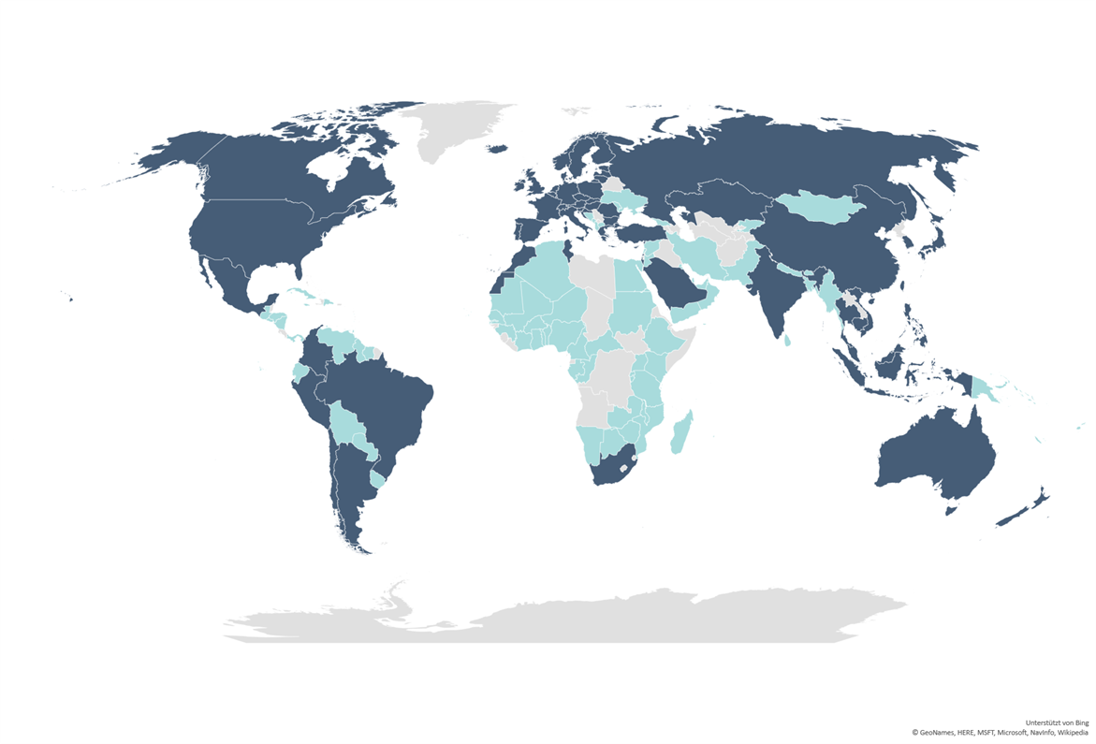
GINFORS-E – Economic structure, Energy and Emissions
Global macroeconometric model
Myopic agents
Non-equilibrium (positive macro impacts possible)
Solves annually
Consistent projections until 2050
Changes in carbon prices affect all
sector prices via the (direct and
indirect) share of carbon costs
in production
(e.g. higher cost of steel make
car production more expensive)

Slide 9
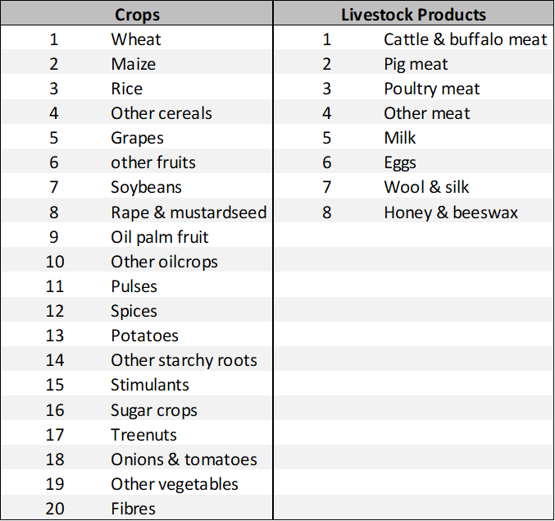
BEST: Model Requirements
GINFORS-E not suitable for modelling bioeconomy yet
  OECD IO data only have „agriculture, foresty, fishery“
  Linking bioeconomy to SDGs requires specific information about crops and where and how they are produced
Physical material flow models based on FAO supply-utilization accounts miss wider economic structural change
Hybrid model combining the best of both worlds
  GINFORS-E provides comprehensive description of structural change of the world economy
  Econometric Agriculture Module: Biomass production, consumption and trade based on detailed FAO data
Agricultural products in the new agriculture module

Slide 10
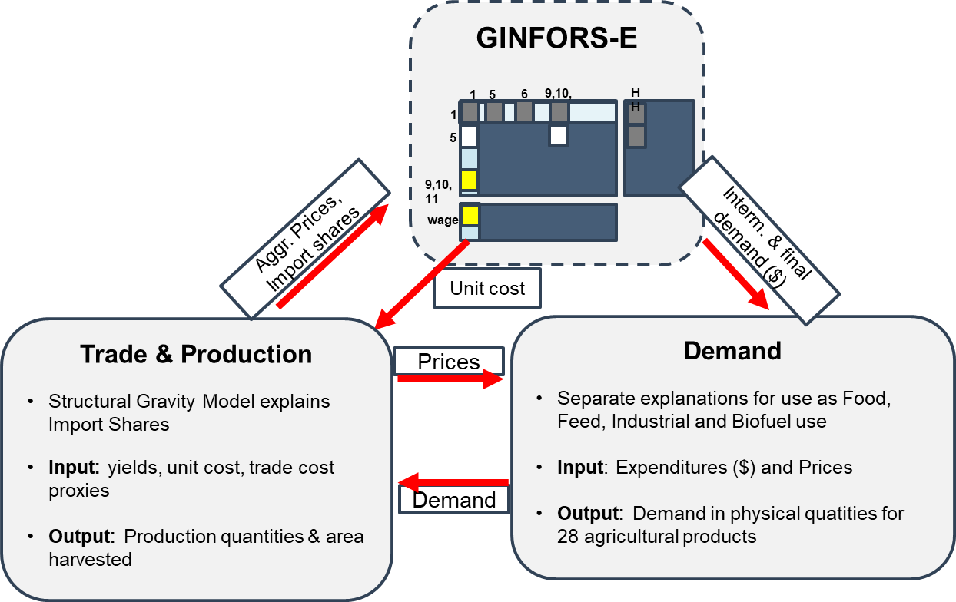
Modelling Setup
Technology in Agriculture
Yields
Livestock productivity
Bioeconomy Development
Biofuels
Feedstock in Chemicals

Slide 11
Demand for Agricultural Products
Data sources
  FAO Supply-Utilization accounts: Food, feed & industrial use in physical quantities
  FAO Production accounts: Prices of agricultural products
  OECD-FAO Agriculture Outlook: Biofuel production & use
  All physical flows expressed in raw material equivalents
Top layer (from GINFORS-E)
Expenditures for agricultural products by
Households: Expenditure-, Own- and Cross-price Elasticities (USDA, 2011, 2014)
Industry: Scenarios for biofuel and feedstock in chemical industry
Mid layer: Demand for aggregate crop and livestock groups
Econometric demand equations with country fixed effects for aggregate
product groups (e.g oil crops, cereals) and uses (food, feed & industrial use)
Expenditures and further variables depending on product group and use category
Biofuel use explained by energy module and scenario specific
Bottom layer: Explains shares of crops in aggregate product groups
Econometric specification shares of individual products based on relative prices
Assumption: within a product group individual products can be substituted
e.g. soybean oil vs. palm oil

Slide 12


Examples for mid-layer explanations (OLS-regressions with country-wise fixed effects) [1]
Oil crops
xq_live: Production quantity livestock
pigsh: Share of pigs in livestock
duq_bfc: Domestic use quantity basic food crops (wheat, rice, pulses,
potatoes, other starchy roots)
iuabcr: Intermediate use of agriculture by chemistry, price deflated

Slide 13

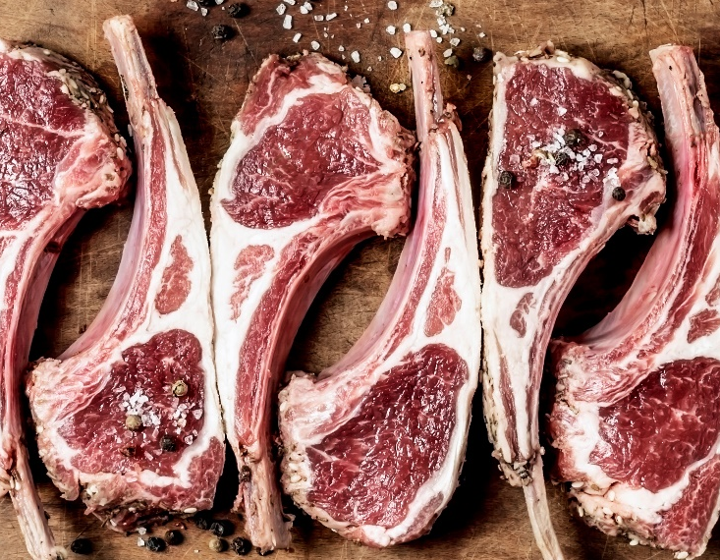
Examples for mid-layer explanations (OLS-regressions with country-wise fixed effects) [2]
Fruits and vegetables
tdaur: Total domestic agriculture & food expenditures from top layer,
price deflated
Meat
tdaur: Total domestic agriculture & food expenditures from top layer,
price deflated

Slide 14

International Trade, Production and Land use
Structural Gravity Model (Reimer & Li, 2009)
Explains bilateral trade by exporter and importer specific effects and trade cost
  Exporter fixed effects measures exporter‘s relative comptitiveness
  Importer fixed effects measure importer‘s market attractiveness
  Trade Cost Proxies: Distance, same language, same country
  2-Step approach:
Estimate Gravity Equation as Generalized Linear Model (GLM) with time and product specific exporter and importer fixed effects
Explain EXP FEs by unit costs and relative yields and IMP FEs by total demand
$$π_{i}^{rs}\left(t\right)=\exp_{i}^{r}\left(t\right) {imp}_{i}^{s}\left(t\right)\exp\left\{α_{i}{dist}^{rs}+β_{i}{lang}^{rs}+γ_{i}{same_cou}^{rs}\right\}$$
Import share of exporter r in country s for good i in year t
Importer/Exporter Fixed Effects
Trade cost $t_{i}^{rs}$ between r and s

Slide 15
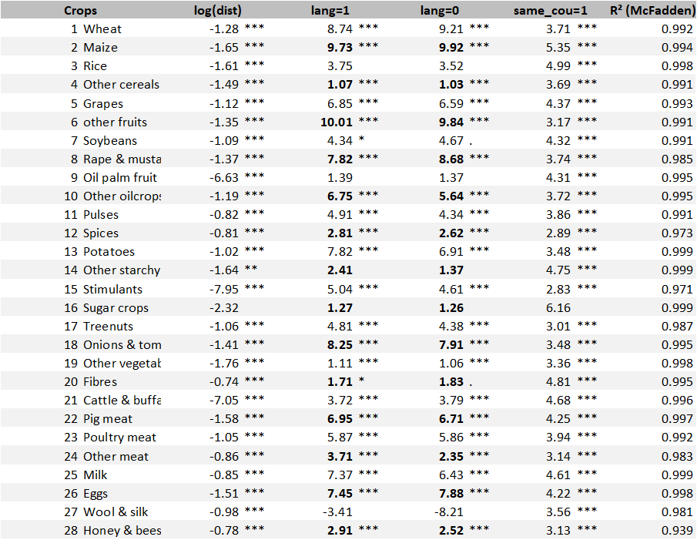
Estimating the Gravity Model
Results of the gravity equation estimates
Data: Bilateral Trade matrices (FAO), Tradecost Proxies (CEPII)
Estimated as Generalized Linear Model (GLM): Allows unbiased esitmation taking frequent zero-flows into account (Santos Silva & Tenreroy, 2006)

Slide 16
Explaining Exporter and Importer Fixed Effects
EXP FE measures relative competitiveness of exporter
Linear econometric model explaning the time specific EXP FEs from Step 1 by
  uc = Producer Price Index of Agriculture (OECD Stan)
  yield_rel = product specific yield (t/ha) or livestock productivity relativ to global average
  t = Trend
Results of regression on Exporter FE
$$\exp_{i}^{r}\left(t\right)={exp⁡_base}_{i}^{r}+α t+β\ln\left[{uc}^{r}\left(t\right)\right]+γ\ln\left[{yield_{rel}}_{i}^{r}\left(t\right)\right]$$
IMP_FE market attractiveness of importing country
Linear model explainig time specific IMP_FEs from Step 1 by total demand
Results of regression on Importer FE
$${imp}_{i}^{r}\left(t\right)={imp_base}_{i}^{r}+β\ln\left[{demand}_{i}^{s}(t)\right]$$
Output compute using bilateral trade shares and total demands by country and product
Output price index for agricultural products changes proportionally to EXP FE

Slide 17
Main Scenario Parameters
Ginfors IO Core:
  Populaton growth and demographics: For now UN Projections → Add SSP scenarios in the future
  Raw material prices → Agriculture module now explains prices
  Tax rates, exchange rate → held constant for now
Energy Sector (IEA STEPS & SES)
  Renewables: slow base growth, additional growth endogenous depending on carbon prices
  Transportation: Electric vehicles stock
Bioeconomy
  Technological change in agriculture: Yields & Livestock productivity (FAO, 2018)
  Bioenergy (IEA EPT, 2018)
    Share of biofuels in total transport fuels (blending mandates)
    Share of waste and by-products (advanced) vs. crops (conventional) in biofuel inputs
  Feedstock in chemicals (e.g bioplastic) → experiment
    Share of biomass feedstocks vs. Oil and gas in chemical industry.
    Shares of waste and by-products vs. crops in biomass feedstocks

Slide 18
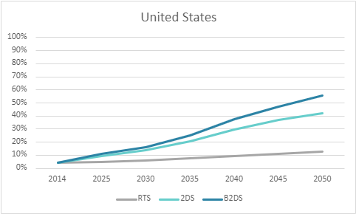
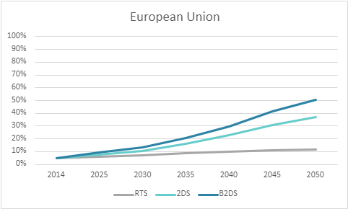
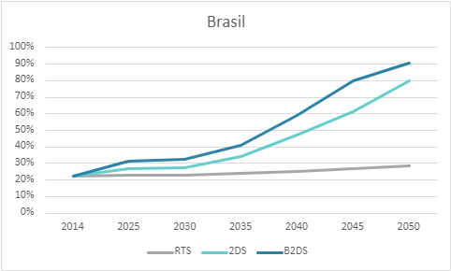
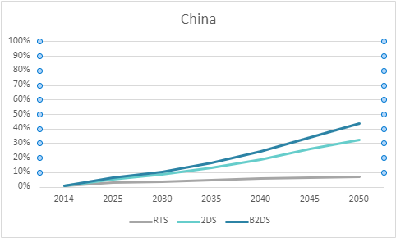
Scenarios: Biofuel Demand
Biofuel blending mandates under different IEA scenarios
Determinants for fuel demand:
  Travel demand (GDP)
  Electric vehicle share (IEA Scenario)
Determinants for crops demand for biofuel use:
  Blending mandate determining biofuel demand
  Share of advanced biofuel using waste and by-products

Slide 19
Scenarios: Biomass Feedstocks in Chemical Industry
Biomass feedstock have the potential to replace crude oil and natural gas in a number of applications:
  Urea
  IEA does not see potential as there are alternative uses with lower abatment cost (bio fuels)
No fixed general targets for EU as of now, but for specific end products
  Preliminary political agreement on a 65% target for recycling of packaging by 2025 and on 70% by 2030 (EU, 2018)
  Biobased plastics central part of EU circular economy strategy
Leaves us room for experiments ☺

Slide 20
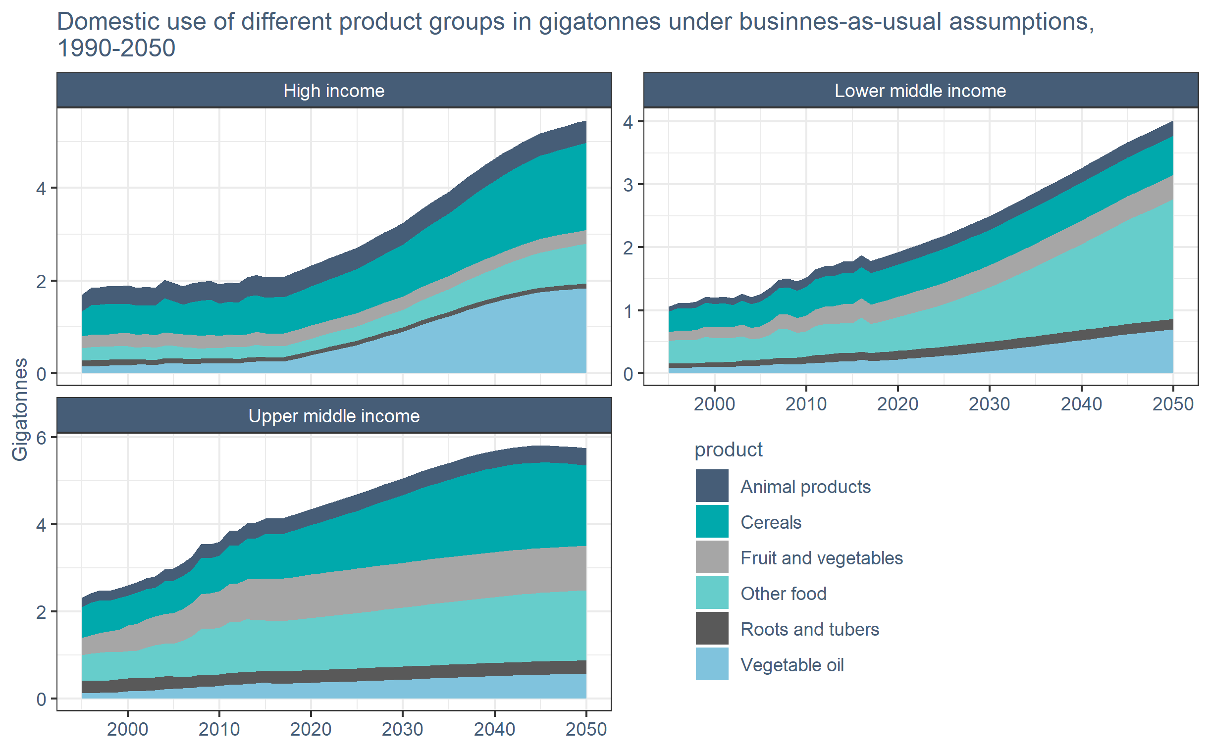
First results: Development of Biomass Demand
Annotation: Country grouping is based on the income classification provided by the World Bank for 2021

Slide 21
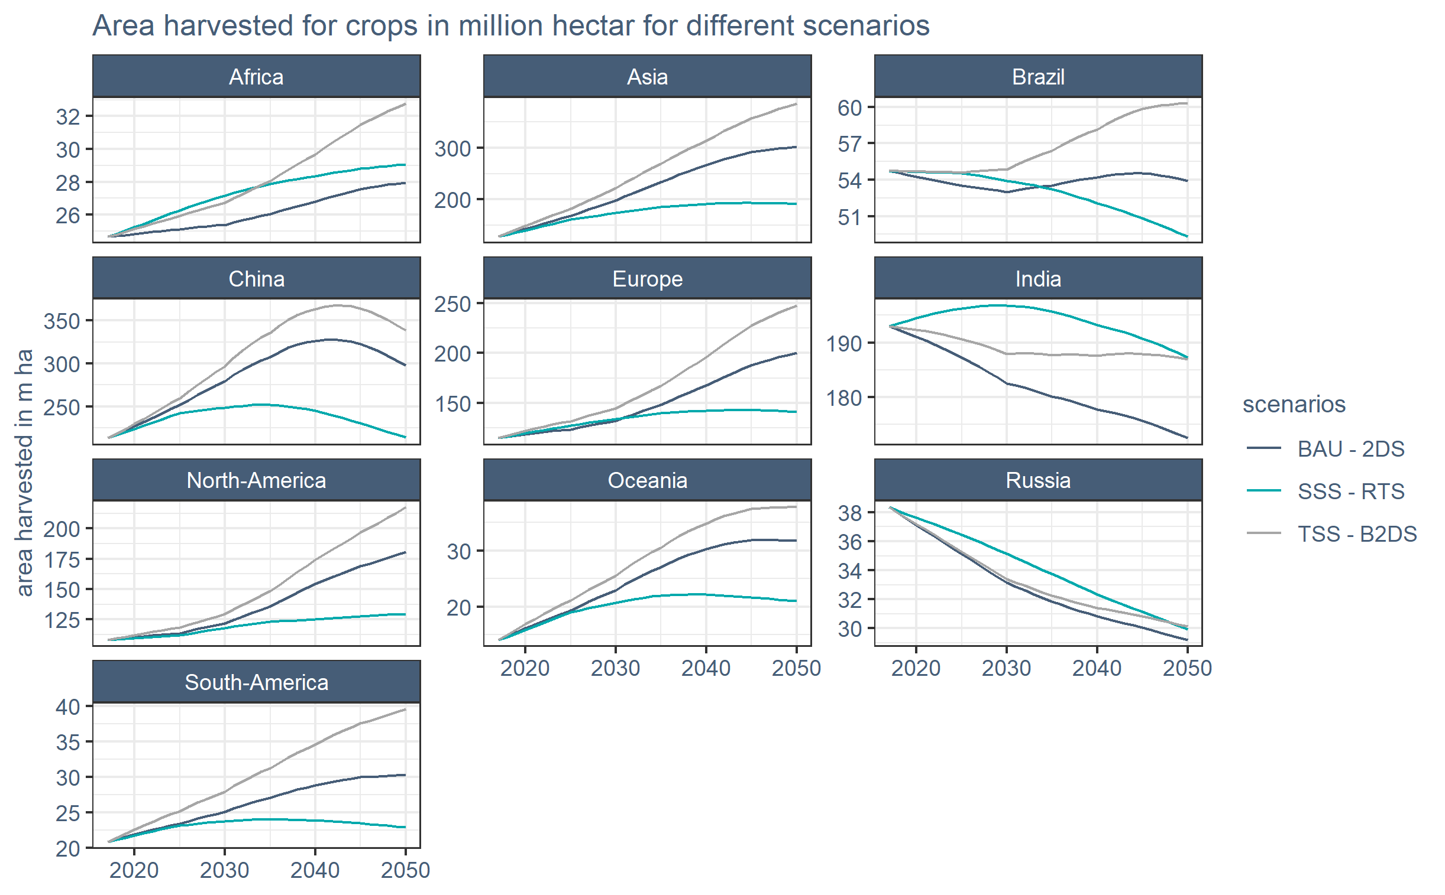
First results: Land use impact under different biofuel scenarios

Slide 22
Outlook
Current state: work in progress
Future work:
  Adding feedbacks between Agriculture Module and GINFORS-E
  Add land price feedbacks restricting the growth of agriculture land
  Link SDG indicators to variables in hybrid model:
    Food prices (zero hunger)
    Water use
    Land use related GHG emissions
    Nutrient use

Slide 23
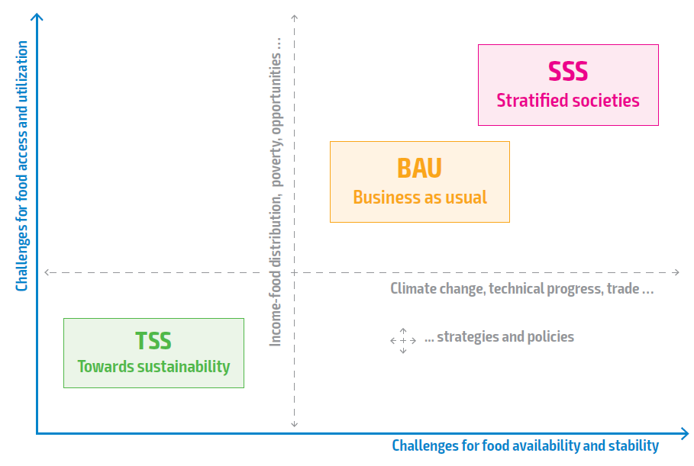
FAO, Agriculture in 2050 Scenarios

