Slide 1
The Russian economy during the COVID -19 crisis. Calculations based on the RIM model А. Shirov

Slide 2
Tasks of economic analysis and forecasting
The point of unacceptable economic damage
Estimates of the number of workers returning to work, the dynamics of economic recovery
Analysis of the effectiveness of economic support measures
Estimation of economic downturn
LOCKDOWN
EXIT
RECOVERY
- 9%
- 3%
- 2%
II q.
III q.
IV q.
Источники: ИНП РАН

Slide 3
Stages of coronacrisis
Dynamics of production in Manufactory, growth rate, y/y in%
Dynamics of Retail, growth rate, y/y in%
I – standard business cycle; II – lockdown; III – пrowth based on deferred demand; IV - plateau
Источник: Росстат

Slide 4
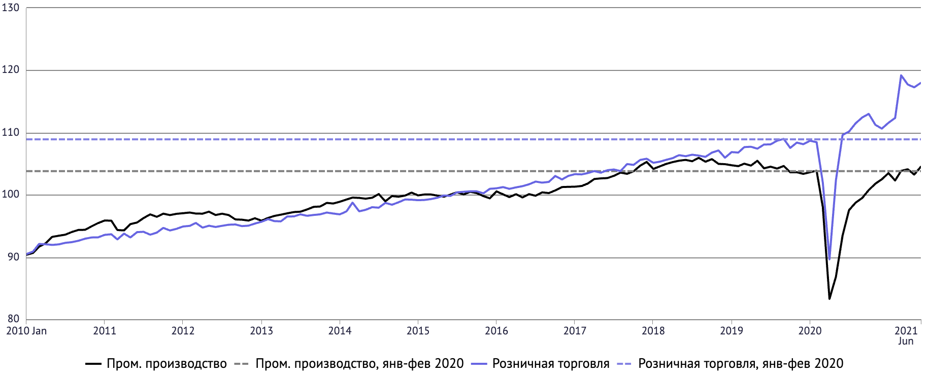
OECD: The race for demand 2015 = 100; season adjustment
Industrial production
Retail turnover
Industrial production and retail turnover in the OECD countries recovered to pre-crisis levels by the end of 2020
Thanks to support measures and deferred demand, consumer demand is growing significantly faster than output in the real sector, which leads to an acceleration of inflation.
Источники: OECD, Eurostat, World Bank, WHO, JHU, OurWorld In Data

Slide 5
Reasons for the difference in economy dynamics for Russia compared to the European Union and the USA:
Russia has a smaller share of the service sector
2. Macroeconomic stability has been achieved as a result of:
2.1. accumulation of funds in the NWF
2.2 low level of public debt
2.3. low inflation
3. High adaptation to external economic shocks since 2014 as a result of:
3.1. import substitution policies
3.2. monetary policy
\

Slide 6
GDP – 2020
Dynamics of GDP production in % by 2019
Final demand dynamics
Factors GDP support in 2020
Government consumption
Outrunning reduction in imports
Support measures for the construction
Fast recovery in Manufactory

Slide 7
Contribution to GDP by Elements
 | 2012 | 2013 | 2014 | 2015 | 2016 | 2017 | 2018 | 2019 | 2020
GDP, growth in % | 4,0 | 1,8 | 0,7 | -2,0 | 0,2 | 1,8 | 2,8 | 2,0 | -3,1
Contribution to GDP by Elements, in p.p.
Household consumption | 4,1 | 3,0 | 1,2 | -5,7 | -1,4 | 1,9 | 2,3 | 1,7 | -4,8
Government consumption | 0,4 | 0,0 | -0,5 | -0,7 | 0,3 | 0,5 | 0,2 | 0,4 | 0,7
Fixed capital investment | 1,5 | 0,5 | -0,5 | -2,6 | 0,3 | 1,0 | 0,1 | 0,3 | -1,4
Inventory | 0,1 | -2,1 | -1,2 | -0,5 | -0,4 | 0,5 | -0,5 | 0,4 | 0,4
Export | 0,3 | 1,1 | 0,1 | 0,9 | 0,8 | 1,3 | 1,5 | 0,2 | -1,4
Import | -2,7 | -1,1 | 2,1 | 7,1 | 0,8 | -3,5 | -0,6 | -0,8 | 3,4
Statistical discrepancy | 0,3 | 0,4 | -0,5 | -0,5 | -0,2 | 0,1 | -0,2 | -0,2 | 0,0

Slide 8
Mortality in Russia in 2020
Number of deaths by month in Russia, thousands of deaths
January-August 2021:increase in mortality by 18.5% by 2020 and by 25.6% by 2019
8
Источник: Росстат

Slide 9
The elasticity of macroeconomic indicators with an increase in oil prices by $ 10/barrel
Changes in macroeconomic indicators in an alternative scenario | 2021 | 2022 | 2023
GDP | +0.5 п.п | +0.2 p.p. | 0.0 p.p.
Households | +1.1 p.p. | +0.3 p.p. | +0.1 p.p.
Government | 0.0 p.p. | +0.1 p.p. | 0.0 п.п
Investment | +1.7 p.p. | +0.6 p.p. | +0.2 p.p.
government investment | +0.3 p.p. | +0.4 p.p. | +0.2 p.p.
Import | +2.1 p.p. | +0.6 p.p. | +0.6 p.p.
Real incomes | +0.7 p.p. | +0.2 p.p. | +0.2 p.p.
Growth of budget revenues, trillion. rub. | +1.0 | +0.6 | +0.5
Oil price Brent, $/барр. | +10 | +10 | +10
Exchange rate, Rub/$ | -3.0 | -4.0 | -5.0

Slide 10
Estimation of long-term economic growth rates in Russia in the inertial scenario
Источник: Росстат; расчеты ИНП РАН

Slide 11
Final Demand
GDP, 2019 =1
Fixed capital investment, 2019 = 1
PCE, 2019 = 1

Slide 12
Sectoral Dynamics, average growth rates, %
 | NON-COVID |  |  | COVID
 | 2018-2022 | 2023-2026 | 2027-2030 | 2018-2022 | 2023-2026 | 2027-2030
Services | 2,4 | 1,8 | 3,2 | 1,1 | 2,7 | 3,1
Manufacrure | 3,4 | 2,3 | 3,2 | 1,8 | 3,3 | 3,1
Mining | 2,6 | 1,9 | 1,8 | 1,1 | 2,2 | 1,8
Energy | 2,3 | 1,1 | 2 | 0,7 | 1,5 | 1,2
Construction | 3 | 2,7 | 4,2 | 1 | 3,7 | 4,2
Agriculture | 2,2 | 2,0 | 1,8 | 2,6 | 2 | 1,8
GDP | 2,9 | 2,1 | 3,2 | 1,5 | 3 | 3

Slide 13
Спасибо за внимание!
www.ecfor.ru
schir@ecfor.ru

