Slide 1
21st ANNUAL INFORUM CONFERENCE – VIRTUAL CONFERENCE , 11th OCTOBER 2021 – 13th OCTOBER 2021
SUB-SAHARAN MACRO-ECONOMIC IMPACT MODELS
Conningarth Economists Pretoria
David Mullins South Africa
Presented by David Mullins

Slide 2
CONTENTS
The structure of the presentation is as follows:
Overview of the Project
Sub-Saharan African Countries Involved
Methodology and Data Services
Layout of Model
Activation of Model
Data inputs to populate Model
Interpretation of Results

Slide 3
Overview of Project
Macro Economic Impact Model (MEIM) for 21 Selected Sub-Saharan African Countries;
Not Inforum type models , but Standard Input – Output Analysis Models;
Information base can ultimately pave the way for full – fledged Inforum Models;
Based on the Social Accounting Matrix (SAM) for respective countries ;
The Structures of the SAM :
    Activities and Commodities – 37;
    Labour – 3 : Skilled , Semi- Skilled and Unskilled; and
    Household Income 3 : High , Medium and Low.

Slide 4
ACTIVITIES OF THE SAM

Slide 5
Sub – Saharan African Countries Involved
Angola
Botswana
Burundi
Congo
DRC – Congo
Eswatini
Kenya
Lesotho
Malawi
Mozambique
Namibia
Rwanda
South Africa
Tanzania
Uganda
Zambia
Zimbabwe
Comoros
Madagascar
Mauritius
Seychelles

Slide 6
Type of Impacts
Economic ;
  Gross Domestic Product (value added to the national economy);
  Employment creation (creation of new jobs for skilled, semi-skilled, and unskilled workers);
  Capital utilization (investments in machinery, transport equipment, buildings, and other social and economic infrastructure);
  Income generated for Households - High , Medium & Low
  Fiscal Impact (Government Revenue); and
  Balance of Payments.

Slide 7
Type of Impacts - Continued
Environmental
  Greenhouse Gas Emissions
      Carbon Dioxide (CO2);
      Methane (CH4) ;
      Nitrous Oxide (N2O) ; and
      CO2e , Aggregate of the above
      Scarce Resources
      Water Usage;
      Electricity Usage

Slide 8
Methodology and Data Sources
Methodology in Broad
Gross Domestic Product (GDP) is readily available;
Current and constant 2010 prices as well as for nine main sectors;
A variety of methods and sources were used for constructing the Production Account, and balancing it according to individual sub-activities per country; and
The Intermediate Demand was calculated as the difference between the Production and GDP per sub-activities.

Slide 9
Methodology and Data Sources Continued
Data pertaining to the Agricultural Sector for the production is mostly sourced from the following:
Total GDP for the agriculture sector: African Statistics Year Book 2020 compiled by the African Development Bank Group (AfDB), the African Union Commission (AUC) and the United Nations Economic Commission for Africa (ECA).
Sub-sectors:
  Food and Agriculture Organization Database (FAOSTAT);
  International Food Policy Research database (IFPRI);
  Countries own datasets;
  Conningarth Internal Datasets; and
  Previous SAMs for the African countries involved.

Slide 10
Methodology and Data Sources Continued
Data pertaining to the Mining Sector was mainly sourced from the following:
Total GDP for the mining sector: African Statistic’s Year Book 2020
Sub-sectors:
  United States Geological Survey (USGS);
  Countries own datasets;
  Conningarth Internal Datasets; and
  Previous SAMs for the African countries involved.

Slide 11
Methodology and Data Sources Continued
Data pertaining to the Manufacturing Sector was mainly sourced from the following:
Total GDP for the manufacturing sector: African Statistic’s Year Book 2020
Sub-sectors:
  Countries own datasets;
  Conningarth Internal Datasets; and
  Previous SAMs for the African countries involved.

Slide 12
Methodology and Data Sources Continued
Data pertaining to the Tertiary Sector was mainly sourced from the following:
  African Statistic’s Year Book 2020

Slide 13
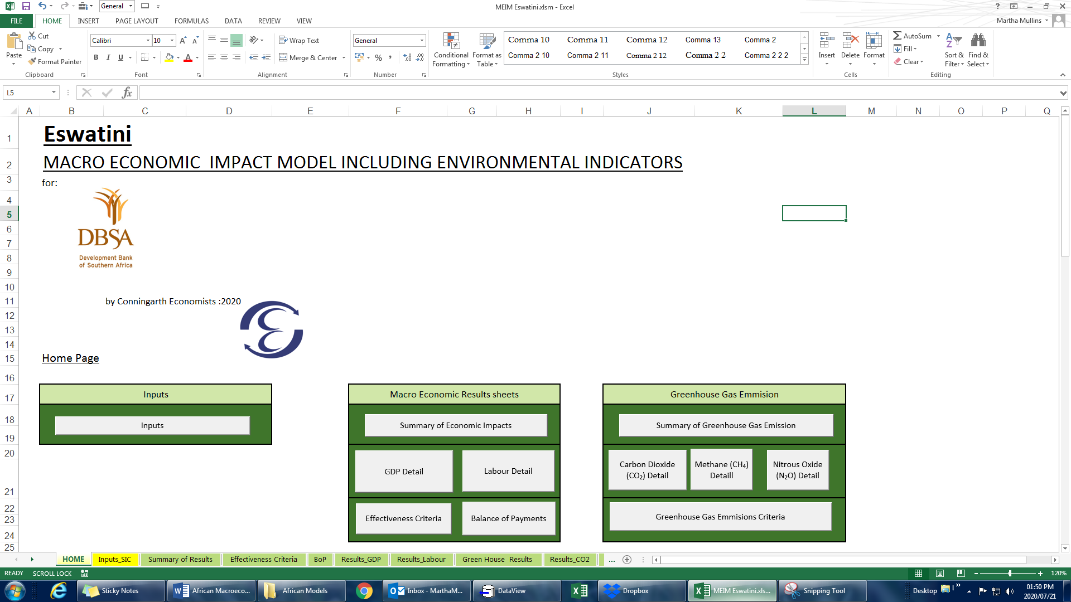
Lay – Out of Model
Activation of Model

Slide 14
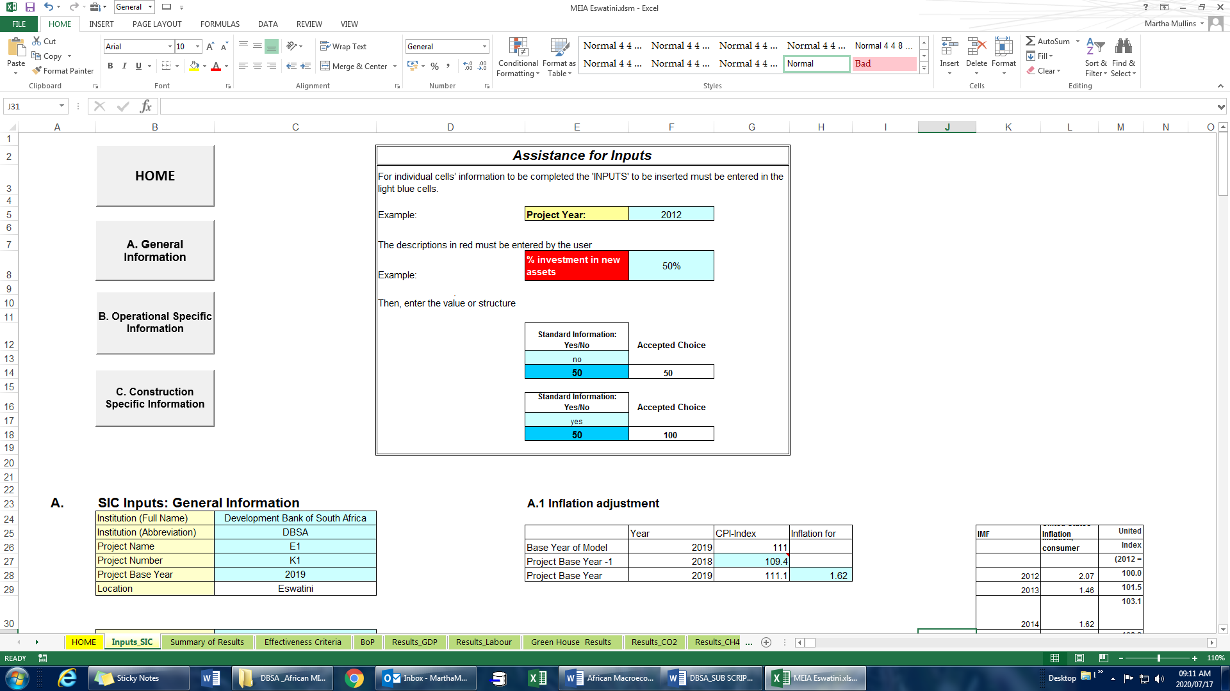
Lay – Out of Model
Data Input to Populate Model

Slide 15
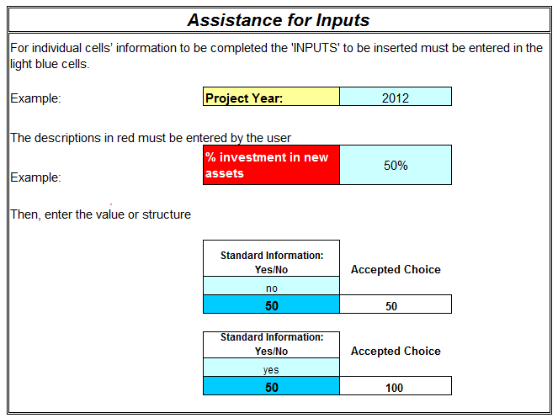
Lay – Out of Model
Inputs – General Information

Slide 16
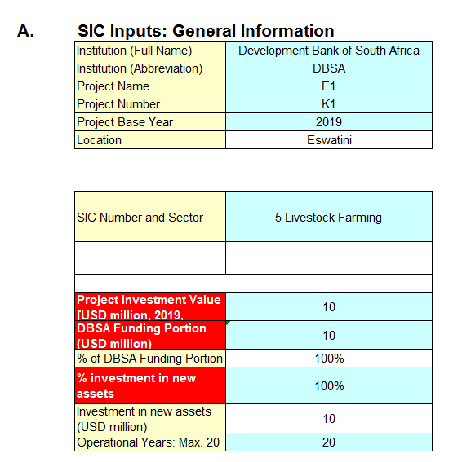
Lay – Out of Model
Inputs – General Information - Continued

Slide 17
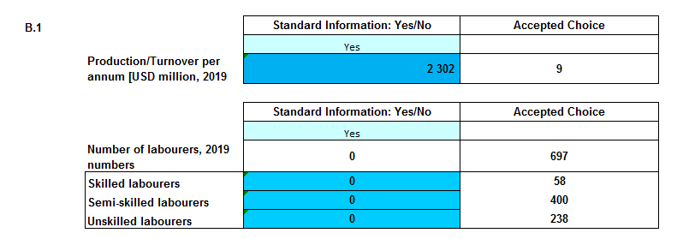
Lay – Out of Model
Operational Phase Specific Inputs

Slide 18
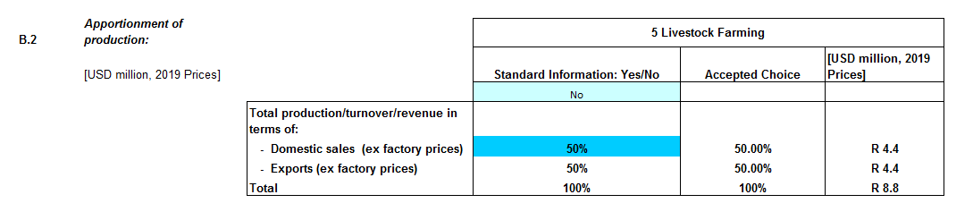
Lay – Out of Model
Operational Phase Specific Inputs - Continued

Slide 19
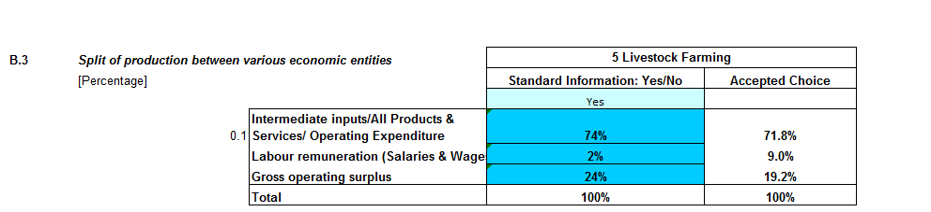
Lay – Out of Model
Operational Phase Specific Inputs - Continued

Slide 20
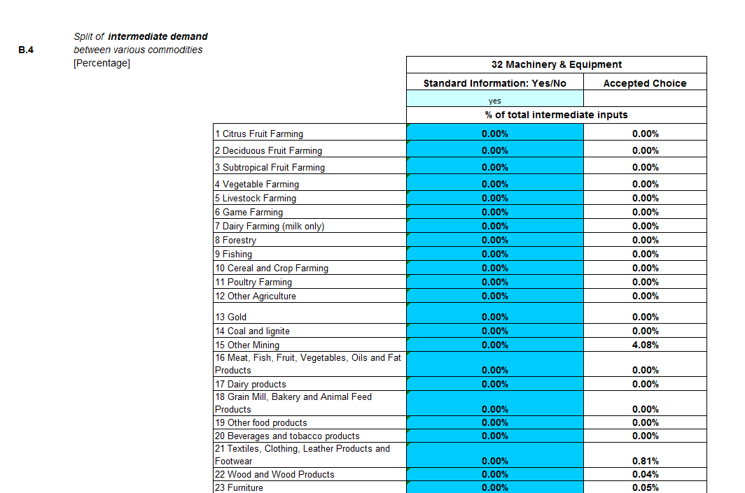
Lay – Out of Model
Operational Phase Specific Inputs - Continued

Slide 21
Lay – Out of Model
Operational Phase Specific Inputs - Continued

Slide 22
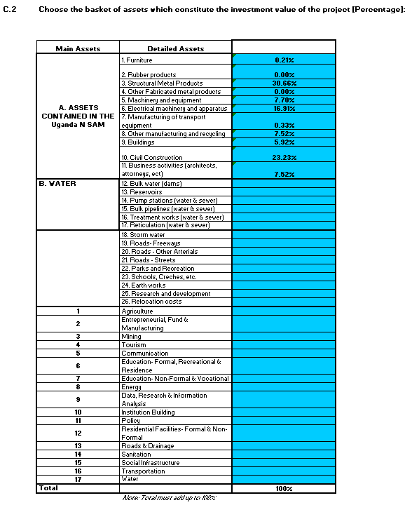
Lay – Out of Model
Construction Phase Specific Inputs

Slide 23
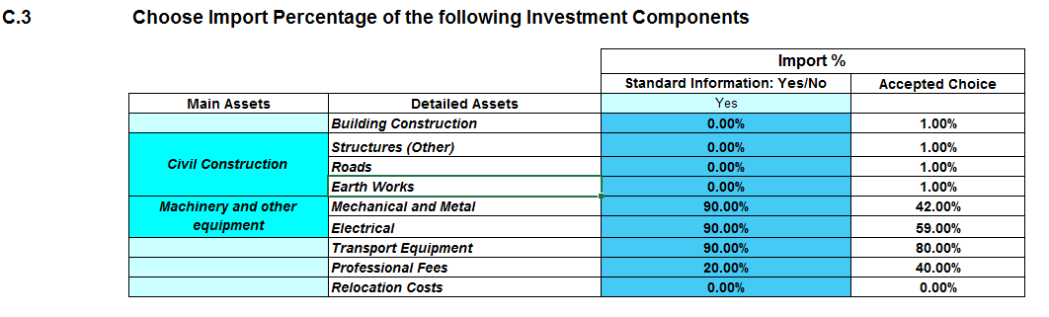
Lay – Out of Model
Construction Phase Specific Inputs – Continued

Slide 24
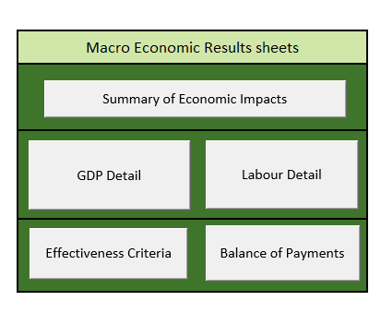
Lay – Out of Model
Interpretation of Results

Slide 25
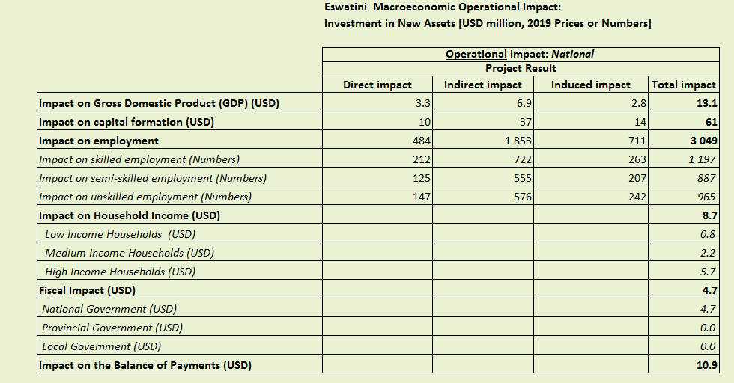
Lay – Out of Model
Interpretation of Results – Macroeconomic Impact Results

Slide 26
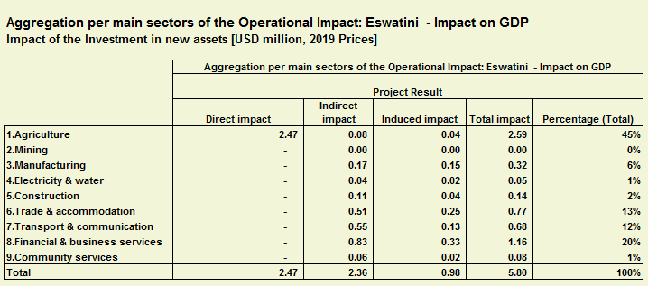
Lay – Out of Model
Interpretation of Results – Macroeconomic Impact Results

Slide 27
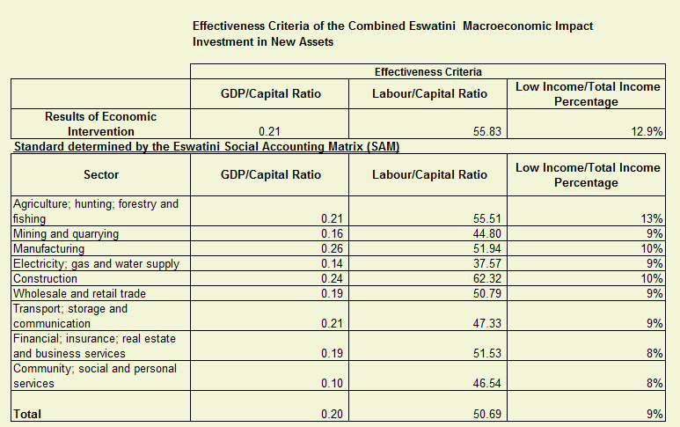
Lay – Out of Model
Interpretation of Results – Macroeconomic Impact Results

Slide 28
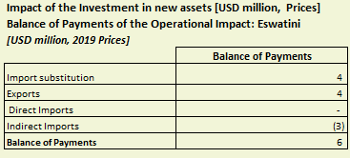
Lay – Out of Model
Interpretation of Results – Macroeconomic Impact Results

Slide 29
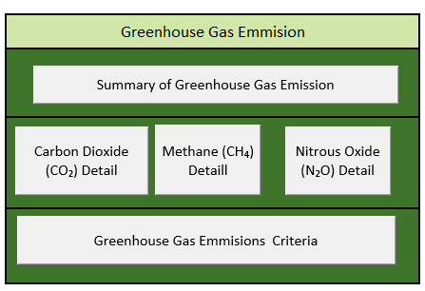
Lay – Out of Model
Interpretation of Results - Environmental Impact Results

Slide 30
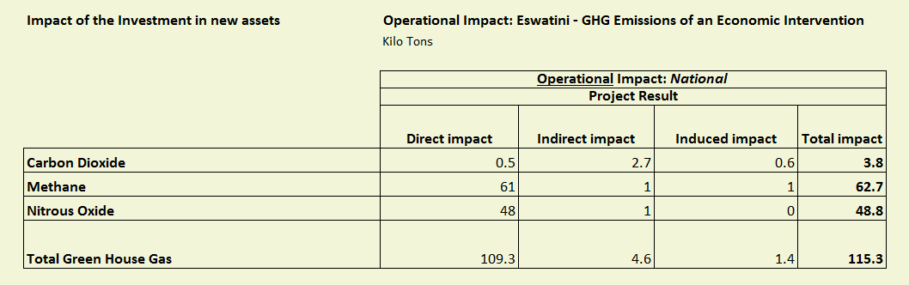
Lay – Out of Model
Interpretation of Results - Environmental Impact Results

Slide 31
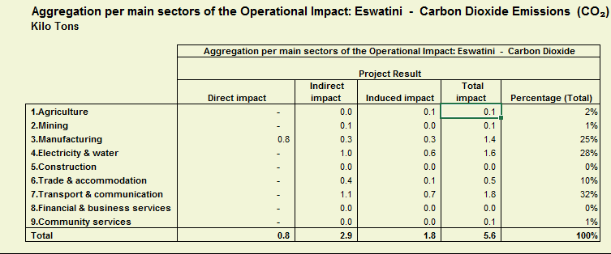
Lay – Out of Model
Interpretation of Results - Environmental Impact Results

Slide 32
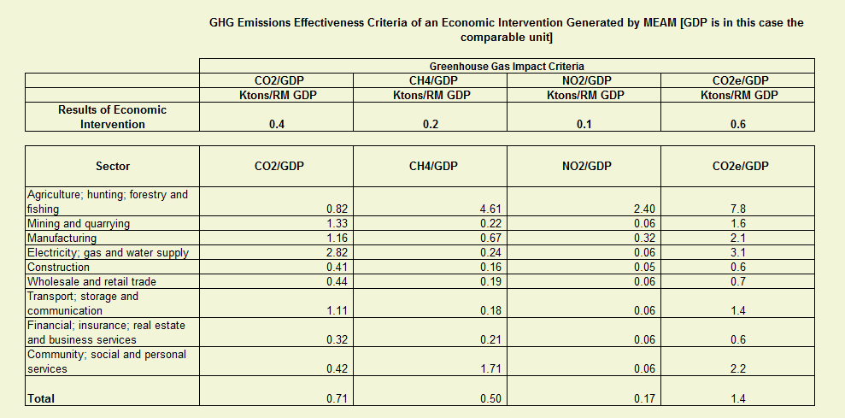
Lay – Out of Model
Interpretation of Results - Environmental Impact Results

Slide 33
Lay – Out of Model
Interpretation of Results - Multi Criteria Decision Analysis
A. Financial Criteria | Profitability: Internal Rate of Return (IRR)
 | Risk Indicator: Benefit Cost Ratio
B. Socio-Economic Criteria | Economic Growth: GDP/ Capital Ratio
 | Economic Participation: Labour Capital Ratio
 | Income Distribution: Low Income/ Total Income Ratio
C. Environment Resource Impact Criteria | Green House Gases: Total Gasses/Capital Ratio
 | Water Usage: Water/ Capital Ratio
 | Electricity Usage: Electricity/ Capital Ratio

Slide 34
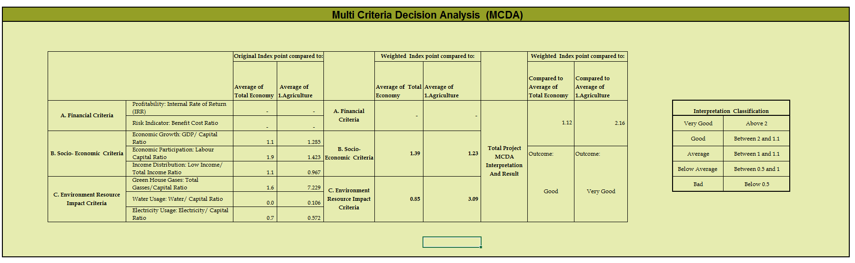
Lay – Out of Model
Interpretation of Results - Multi Criteria Decision Analysis

Slide 35
The End
Thank You

