Slide 1
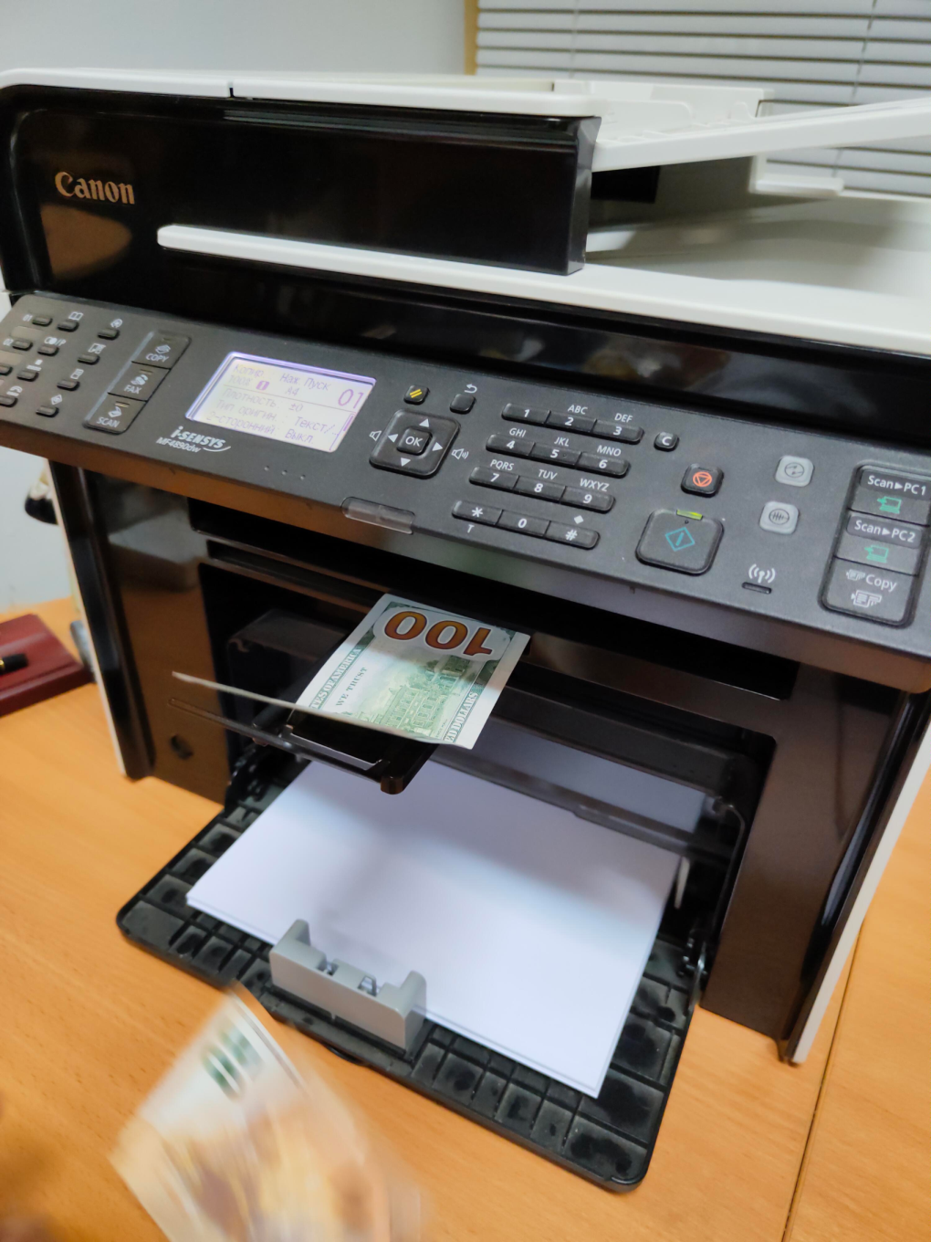
Optimistic markets vs Real economy: Who Will Bear the Brunt of Bringing Them Together?
Anton Moiseev
Deputy director, ECFOR

Slide 2
Initial points – COVID new normality
Markets should have fallen, but they have not. The Central banks have issued massive amounts of money to support them.
The governments issued large stimulus packages. People received unconditional incomes, often brought them to the stock markets. Wealth effect accumulated with markets growth.
Businesses were relieved of bankruptcies and banks were allowed to keep nonperforming loans as if they were normal.
Is financial sector torn from the real sector? How can we measure it?

Slide 3
Measure for real economy. GDP or half-complete deals? - USA
GDP is slow to react and does not show expectations of agents.
The growth in the economy is due to increasing debt. Higher volatility does NOT mean less debt.
When supply lot is delivered and payment delays, there is another account payable. MORE DEALS = MORE DEBT. A half-complete deal is another account payable. Statistics: Other Accounts Payable.
Increasing prices increase debt needed to run the deals.
This is where money could have appeared – to denote half-complete deals.
2018Q4
FRED

Slide 4
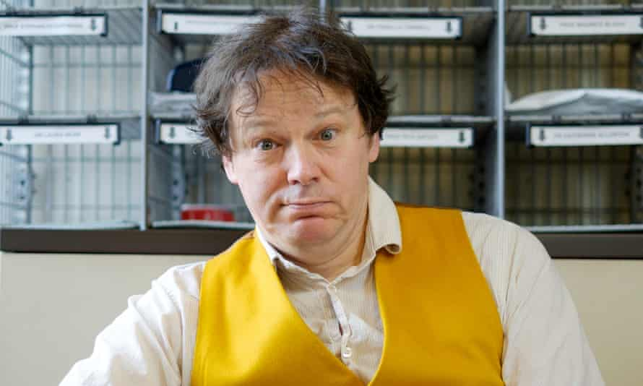
David Graeber, an anthropologist and the anarchist
David Graeber in 2015. Photograph: Frantzesco Kangaris/The Guardian

Slide 5
USA GDP vs Other accounts payable decomposed, $bln
Financial sector accounts payable should reflect those of real sector. So, to estimate demand for money, we should look at non-financial sector accounts.
FRED

Slide 6
Scheme of money creation driven by debt accumulation
Modern monetary theory
says the banks create as much money as economy needs, so the monetary multiplier should be counted another way around: from demand to central liquidity (monetary base).

Slide 7
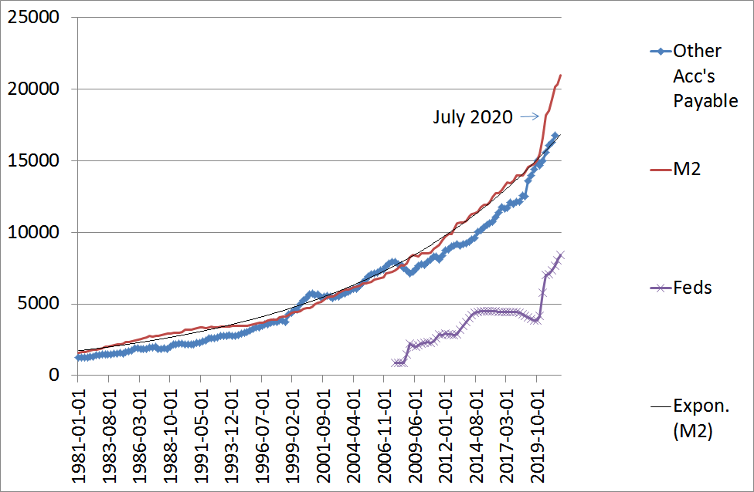
Monetary aggregate M2 vs debt aggregate (B2B debts). Who is the original?
Money created do follow the B2B debt accumulation.
B2B debt = other accounts payable for Nonfinancial Corporate and Noncorporate business + Government
(AP)
Rate of growth for AP shows expectations and forms demand for money. Monetary response follows suit.
FRED

Slide 8
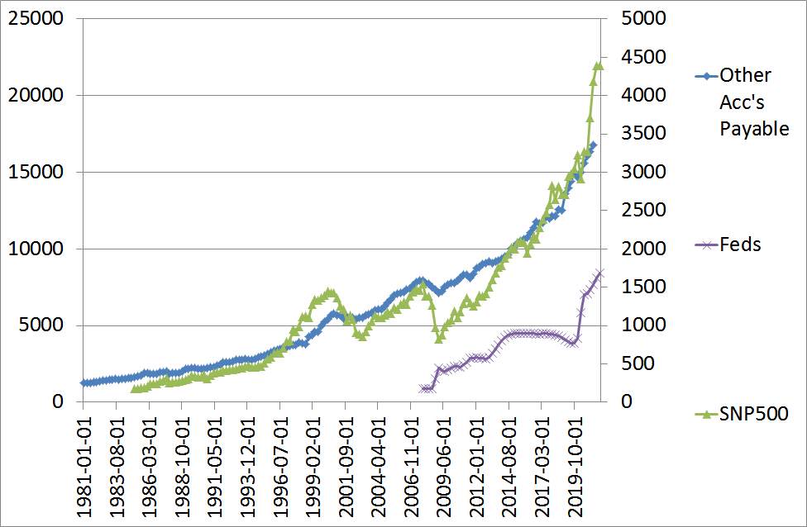
Market index vs B2B debt. Being high?
Markets go with the B2B debt accumulation, multiplied.
FRED

Slide 9
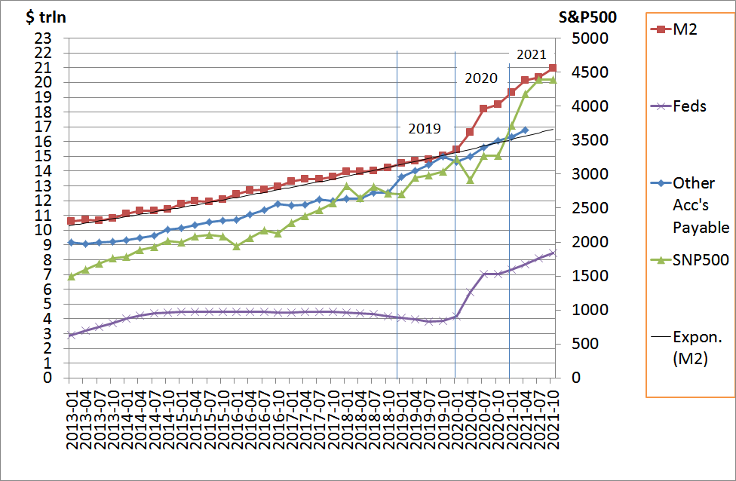
Money, B2B debt, market and the state - USA
Are markets optimistic?
Do they see increased rate of debt generation as inevitable?
FRED

Slide 10
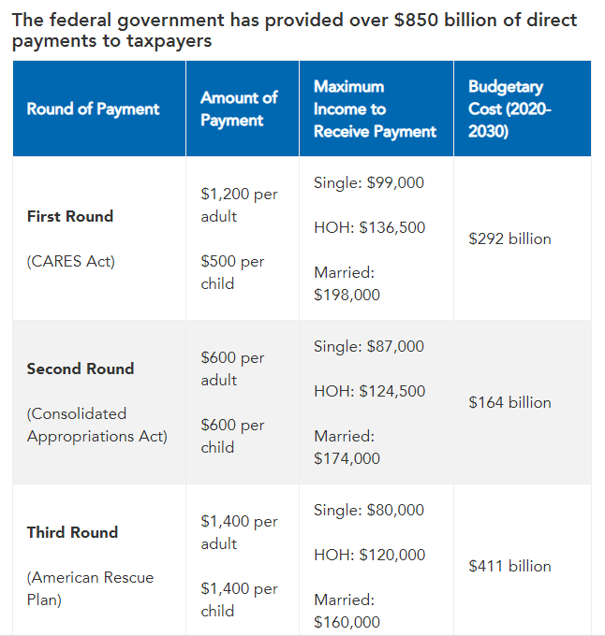
COVID stimulus packages, USA
$271 bln issued in 2020, 162 mln payments.
$135 bln issued in Jan-Feb 2021,
Issuing since Mar 2021.
https://www.pgpf.org/blog/2021/03/what-to-know-about-all-three-rounds-of-coronavirus-stimulus-checks

Slide 11
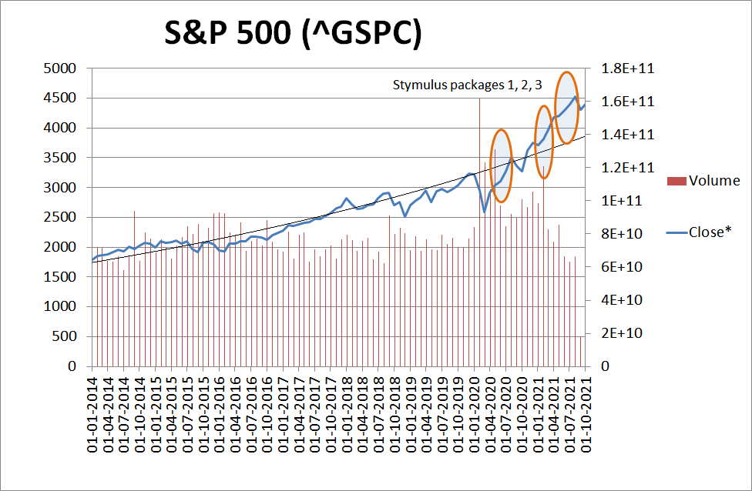
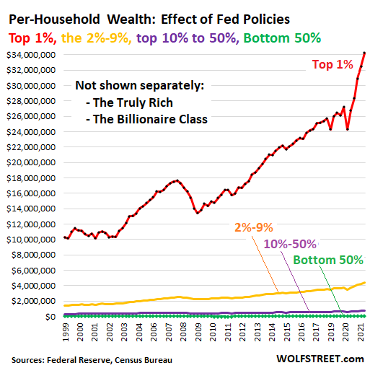
Market too big to fail
Three stimulus packages came to the stock market the next week after they were issued.
This created wealth effect for those who invested. Those who saved in traditional fixed-rate instruments, lost in real terms.
Sources: Yahoo finance; Wolf Richter blog - https://wolfstreet.com/2021/10/02/my-wealth-effect-monitor-for-our-money-printer-economy-is-out-in-the-pandemic-the-fed-totally-blew-out-the-already-gigantic-wealth-disparity

Slide 12
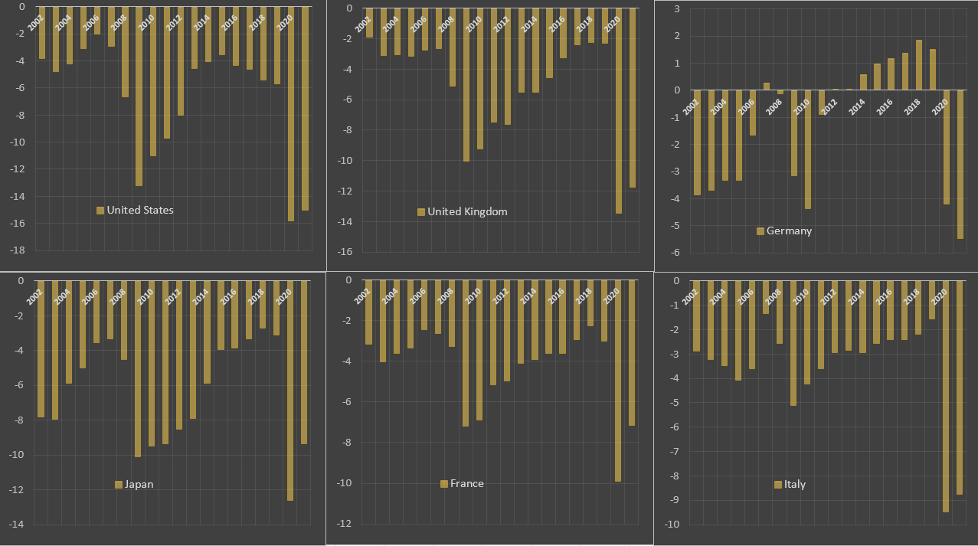
Fiscal responses to COVID in developed countries – budget deficits
Budget deficits to GDP %.
IMF, ECFOR calculations by P. Ryabov

Slide 13
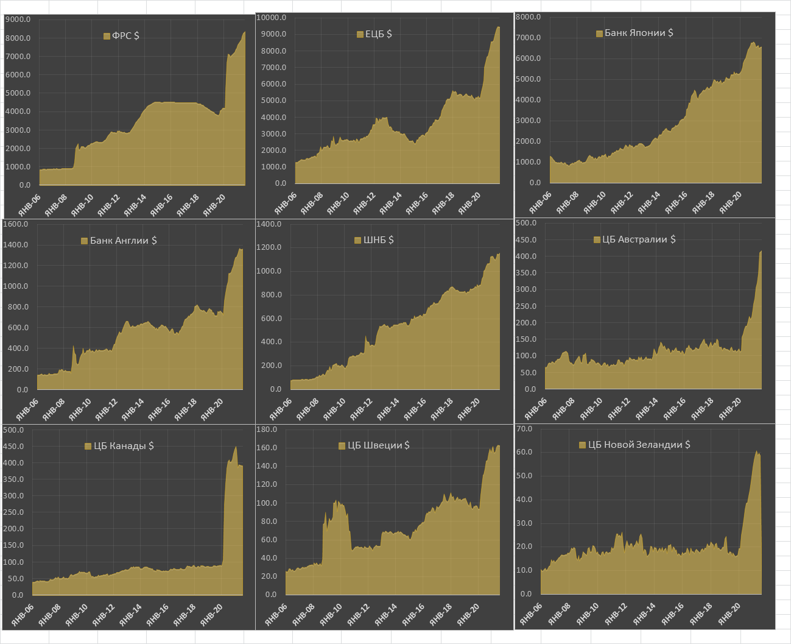
Monetary responses to COVID by Central banks – Total Assets
Sharp monetary responses to COVID – did they create “new normal”?
What would be the speed of money generation for the next years?
Will the debt overhang be compensated by new profits? What would be the necessary price movement to create such profits?
USA
EUROPE
JAPAN
GB
SWITZERLAND
AUSTRALIA
CANADA
SWEDEN
NZ
Sources: Bloomberg,

Slide 14
Russia: Monetary aggregate vs B2B debt
Accounts payable (кредиторская задолженность нефинансовых предприятий) reflect amount of cross-enterprise debt, incurred by deals, i.e. the outlook for demand.
M2, as money generated by credit, should approach AP, being the financial intermediaries’ estimate of the current deals sustainability.

Slide 15
Accounts payable in Russia
Rosstat, ECFOR

Slide 16
Debt or income growth – Russia
After debt accumulation we should have fast income growth or massive debt writeoffs.
1994-1998: massive debt accumulation, income contraction.
1999-2006: incomes overtook.
2007-2009: debts accumulated, crisis time, low incomes.
2013-2016: debts accumulated, income slowed down.
2017-2018: worse outlook, income overtaking
2020: massive debt accumulation.
We can conclude that this coronacrisis costed Russia around 10-11% of GDP, which should be covered either by increasing incomes (through productivity), or by deflating debts by inflation. Either way, first burden of crisis comes upon investors’ shoulders, but then, next year(s) it comes through inflation and reduced investments, thus employment, to poorer people. So, after supporting the banks should come the measures for increasing employment and income support.
ECFOR, Rosstat

Slide 17
Debt or income growth - USA
After debt accumulation we should have fast income growth or massive debt writeoffs.
Higher B2B debt overtake means higher outlook for the future incomes. Lower B2B debt overtake means enterprises make debts slower, while incomes from previous deals still come – more half-complete deals are completed and less are opening.
Still accumulating debt.
FRED

Slide 18
Summary
Money creation is the banking system response to the demand from business. Demand from business is formed by half-complete deals, reflected in the statistics of other accounts payable of non-financial sector.
MONEY IS ENDOGENOUS
“Printing money” today is done through buying out the non-performing debts, substituting private signature with the public one. This accumulates public debt, which can be devalued through inflation or serviced with higher incomes from the economy.
The fund market crisis undermines the wealth of investors, cutting the demand for the technologies and business services, thus impacting developed countries. Inflation undermines the revenues of the poor, impacting the mass production industries, personal services, savings. It hits stronger on the emerging markets.
Increasing the growth rate needs a large fiscal impulse, putting pressure on interest rates and limiting the flexibility of public budgets.
The way we exit pandemics crisis takes us to increased inequality of wealth and incomes. The markets might stay at highs, while the economy has to reach what it missed – first through inflation, next with investment. The question is where will be the prices for investment goods relative to commodities. If these grow slowly, the economy will gain momentum. If they go up with commodities, the economies will operate at new price scales, but real growth rates will be low.

Slide 19
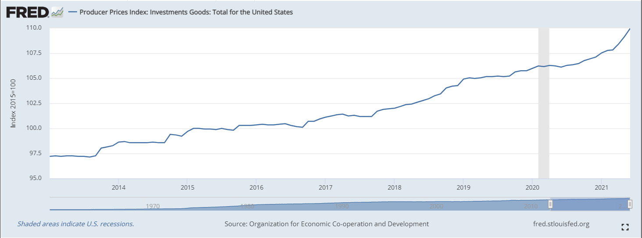
Summary
2021q2

Slide 20
Thank you!
And many thanks to my colleagues, especially, Oleg Govtvan and Pasha Ryabov, for providing data, critics, ideas and company for scientific research.
anton.moiseev@gmail.com

