Slide 1
IO Coefficients Modeling in the Automotive Industry
Sergey Milyakin
INFORUM, 2021

Slide 2
Introduction and methodology
1.

Slide 3
Technological shifts assessment methodology
Exited shifts:
Already happening
2. Observable in the past
3. Econometrical approach
Examples:
Energy use
Composite materials
Digitalization
Partly autonomous driving
New or expected shifts:
Will happen possibly
2. Not observable in the past
3. Scenario analysis
Examples:
Electric cars
Fully autonomous driving

Slide 4
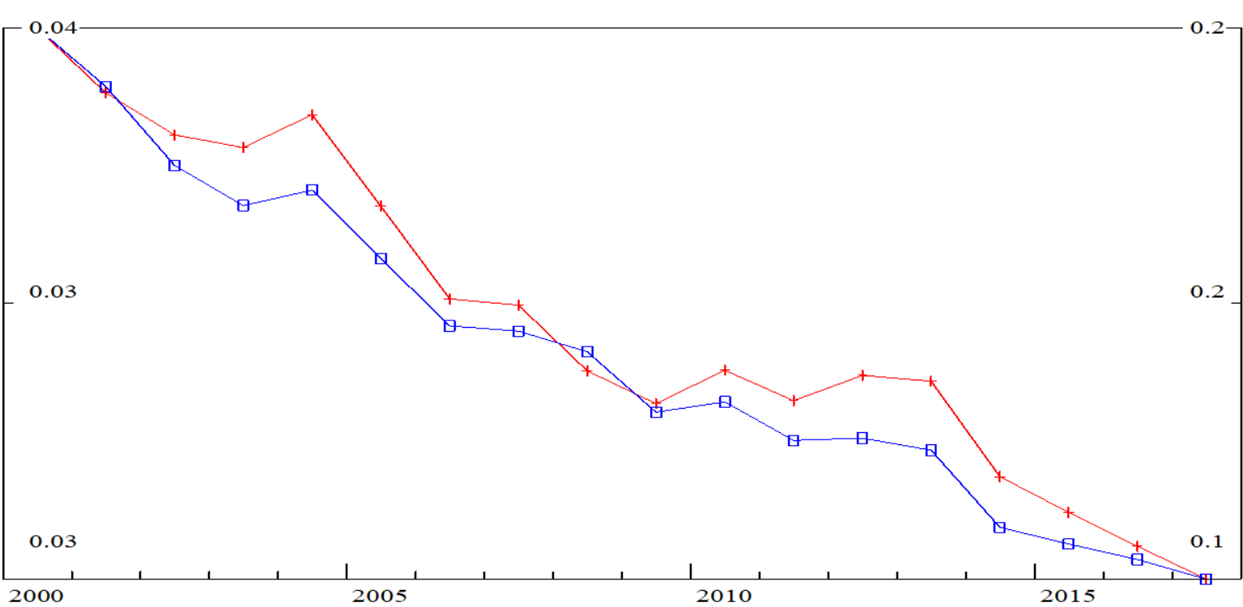
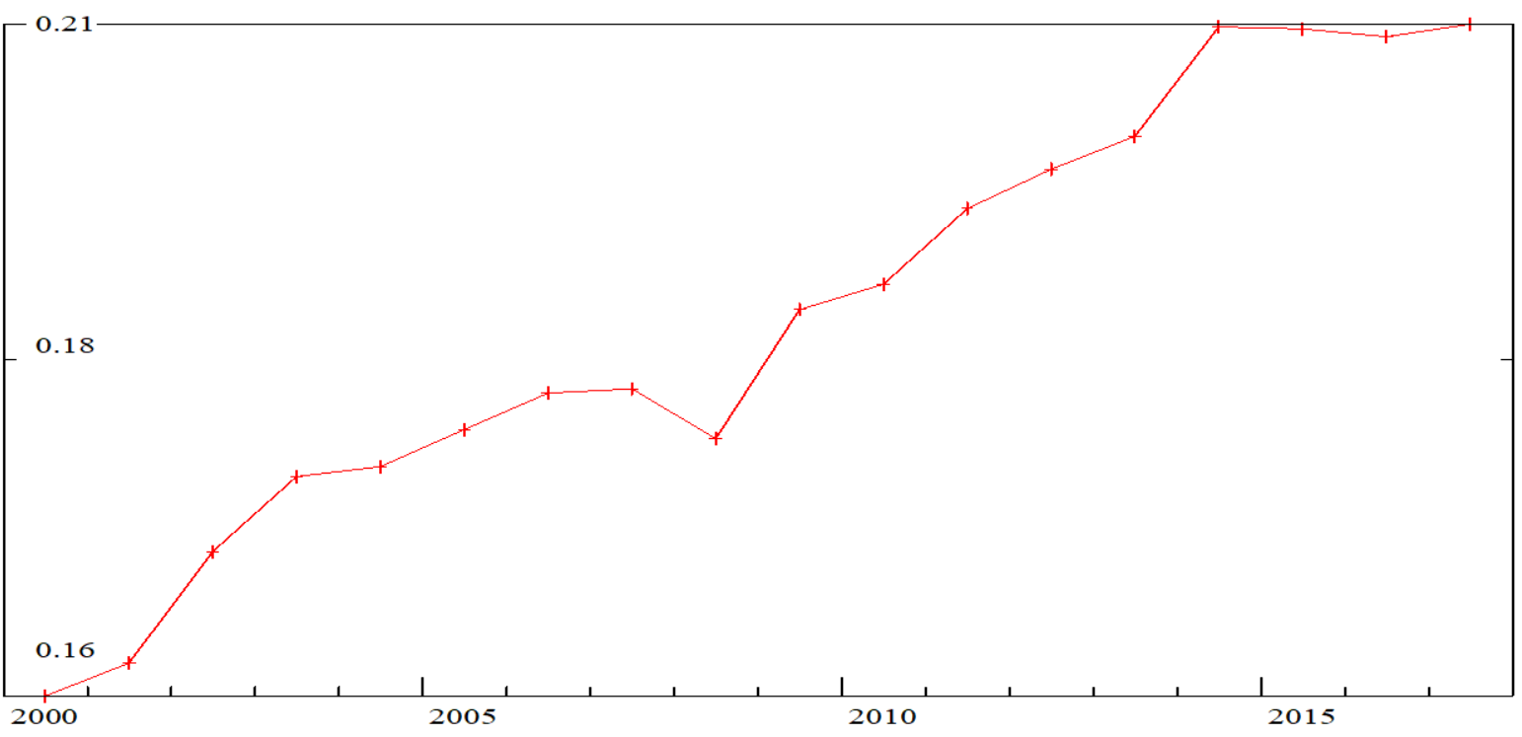
“Reflection” of the shift
In “Automobile and automobile equipment production”
From “Chemistry” (red, left axe)
From “Ferrous metals” (blue, right axe)
Relation “Chemistry” / “Ferrous metals”
+30%

Slide 5
Relation analysis
 | Chemistry | Ferrous metals | Nonferrous metals | Metal products
Chemistry
Ferrous metals
Nonferrous metals
Metal products

Slide 6
Relation analysis
 | Chemistry | Ferrous metals | Nonferrous metals | Metal products
Chemistry |  | Composite materials spread
Ferrous metals |  |  | Light materials spread | Light or composite materials spread
Nonferrous metals |  |  |  | Light or composite materials spread
Metal products

Slide 7
Technological shifts in Automobile industry
Gasification and coal usage decline
Composite and light materials spread (energy efficiency growth)
Partly autonomous driving and saloon comfort rise
Digitalization and services share growth

Slide 8
Gasification and coal usage decline
2.

Slide 9
Gasification and coal usage decline
 | Gas | Coal | Petroleum products | Electricity
Gas
Coal
Petroleum products
Electricity

Slide 10
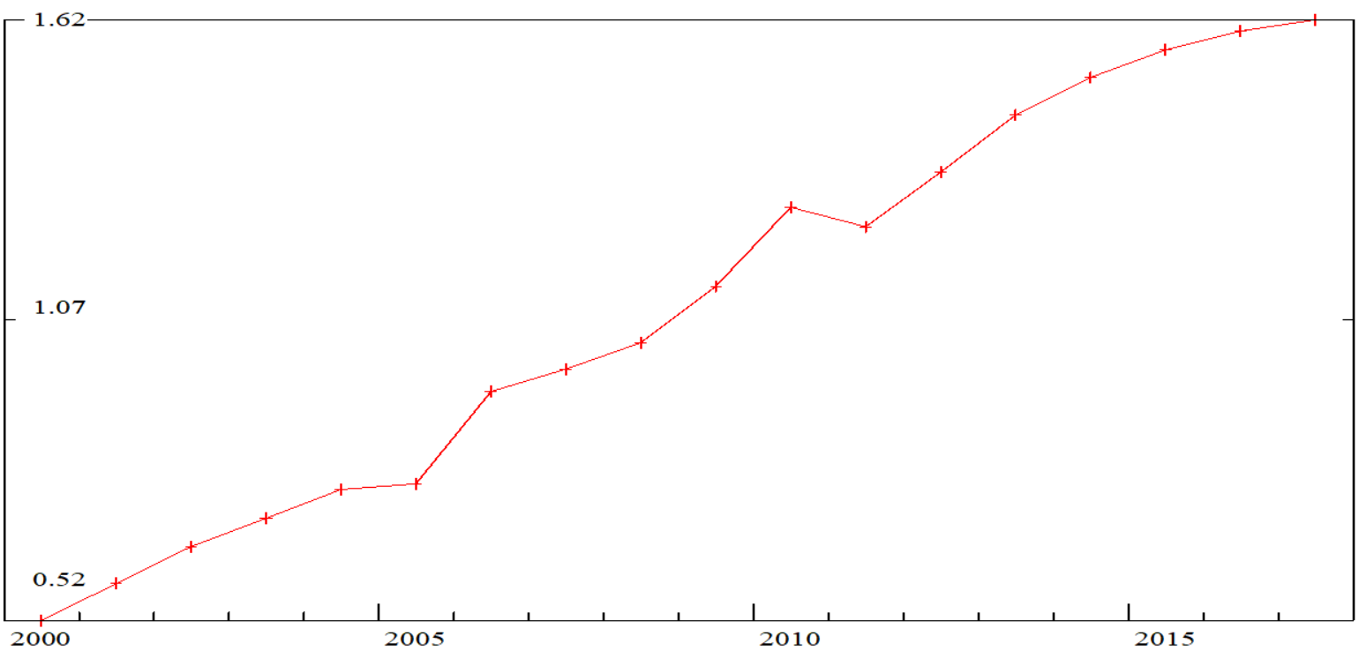
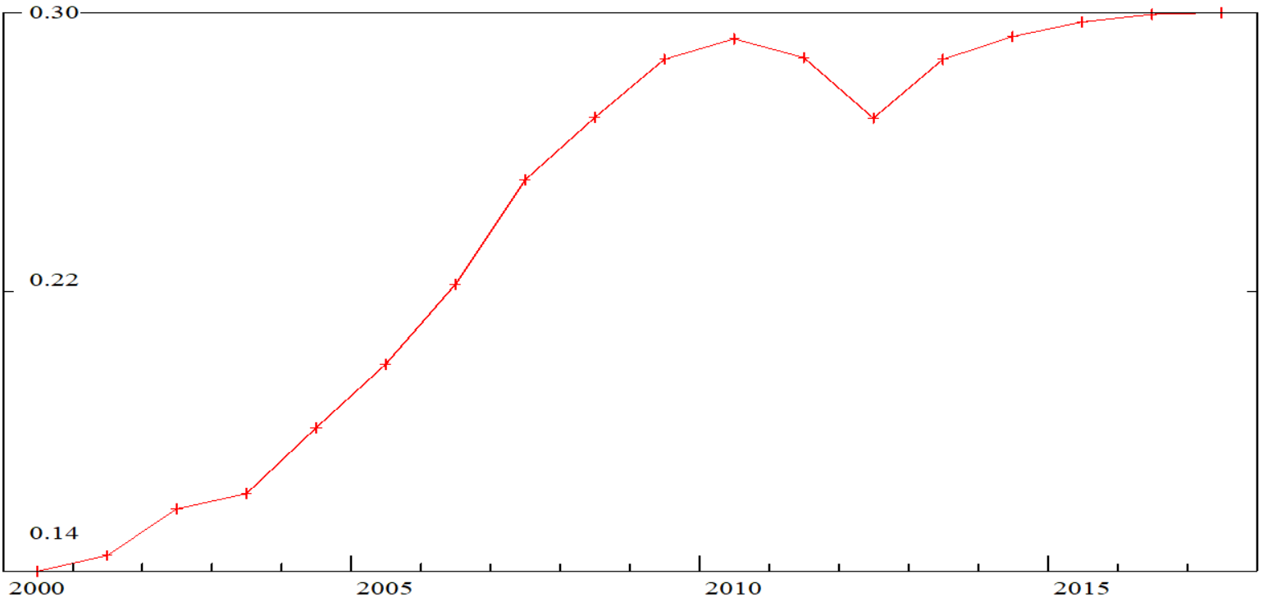
Gasification and coal usage decline
Gas / Coal
Gas / Petroleum products
+215%
+118%

Slide 11
Composite and light materials spread
3.

Slide 12
Composite and light materials spread
 | Chemistry | Ferrous metals | Nonferrous metals | Metal products
Chemistry
Ferrous metals
Nonferrous metals
Metal products

Slide 13
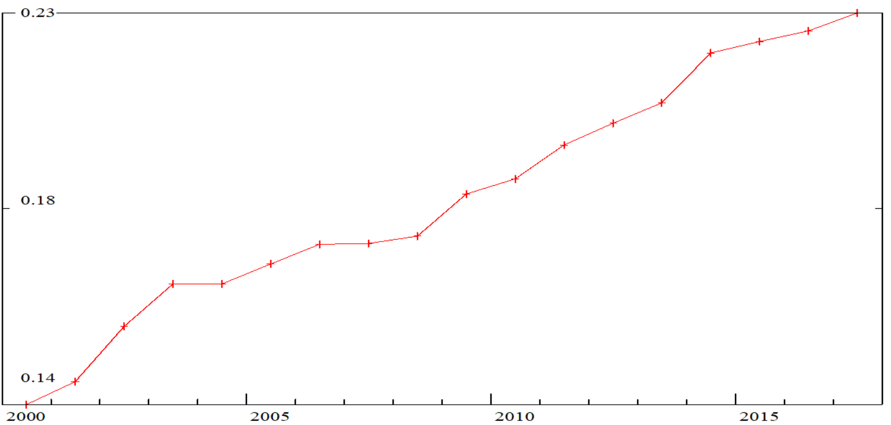
Composite and light materials spread
Nonferrous / Ferrous
Chemistry / Ferrous
+59%
+30%

Slide 14
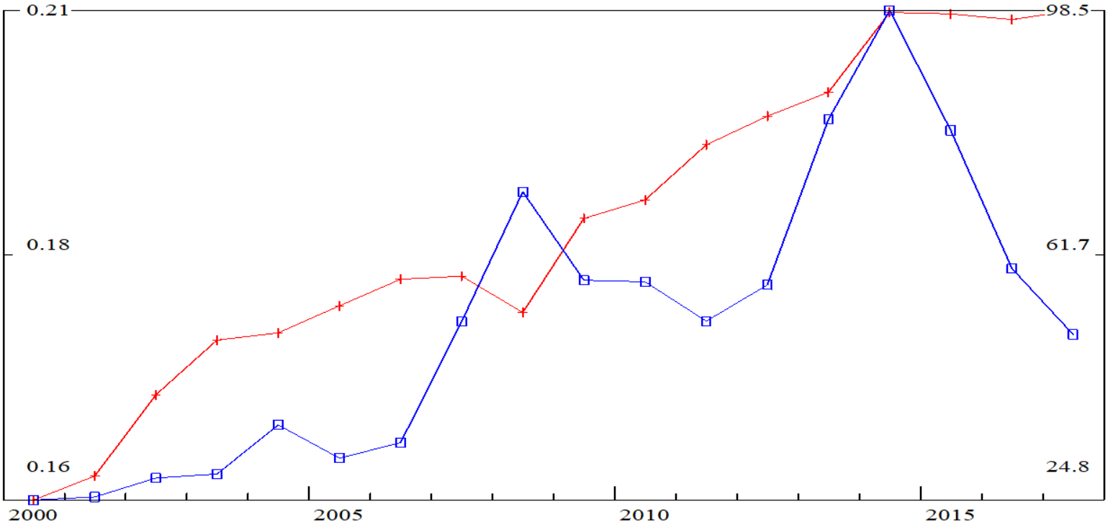
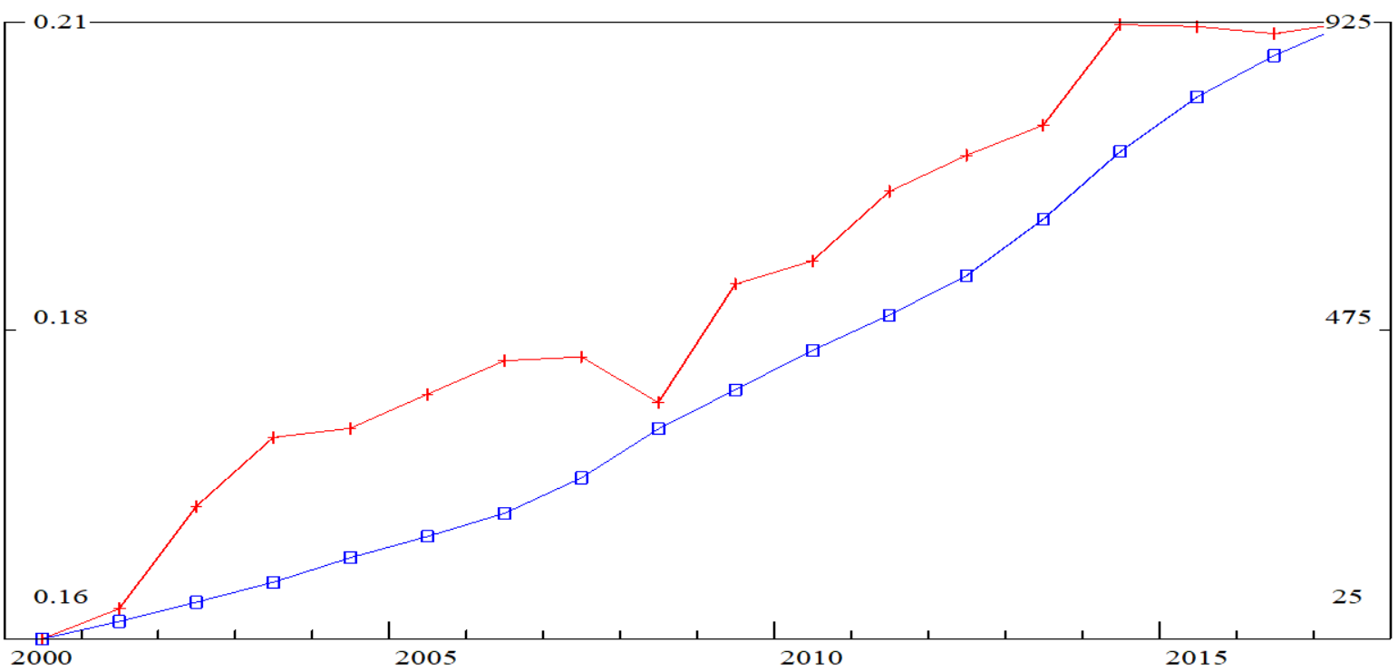
Composite materials vs. Ferrous Metals
From “Chemicals” to “Automobiles & equipment “/ From “Ferrous metals” to “Automobiles & equipment “
Relation (red line, left axis)
Investments in Automobile industry (blue line, right axis)
Relation (red line, left axis)
Accumulated investments since 2000 with zero retirement (blue line, right axis)

Slide 15
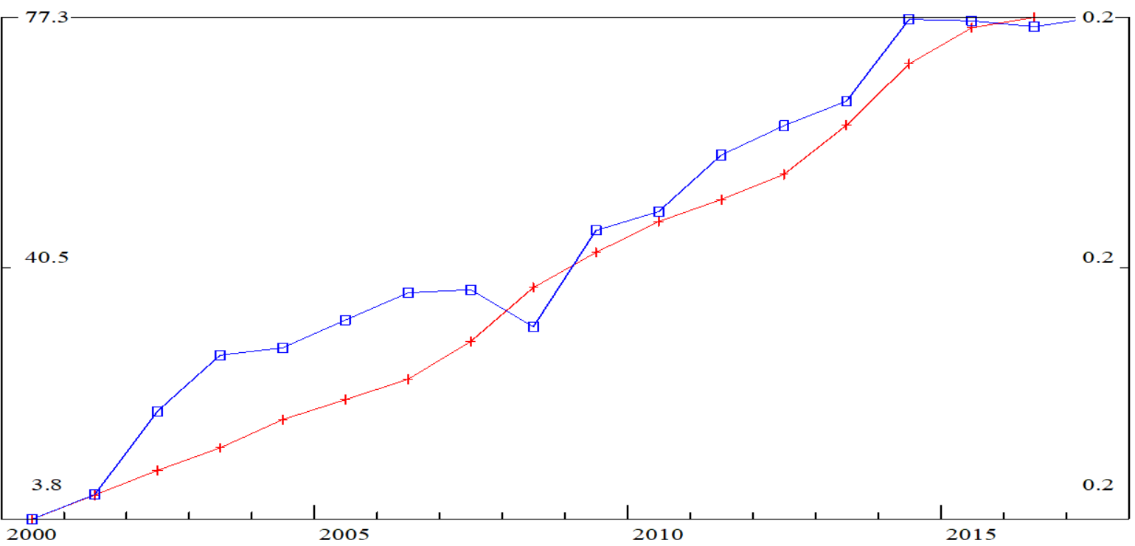
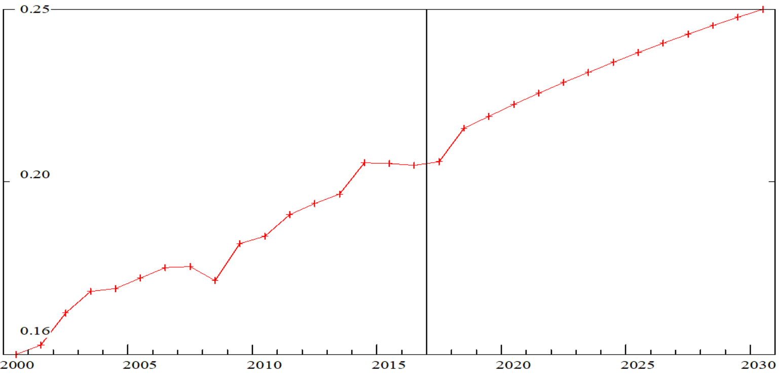
Composite materials vs. Ferrous Metals
From “Chemicals” to “Automobiles and equipment “/ From “Ferrous metals” to “Automobiles and equipment “
Predicted (red line, left axis)
Actual(blue line, right axis)
+19% 2030/2017

Slide 16
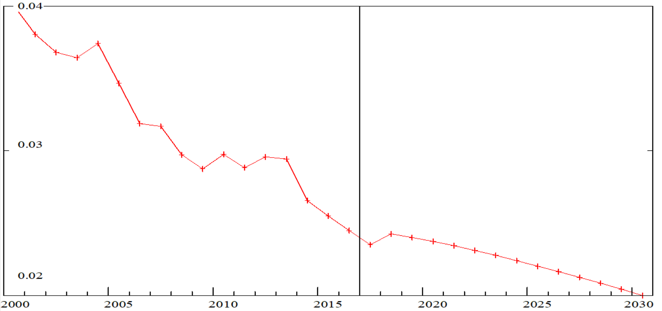
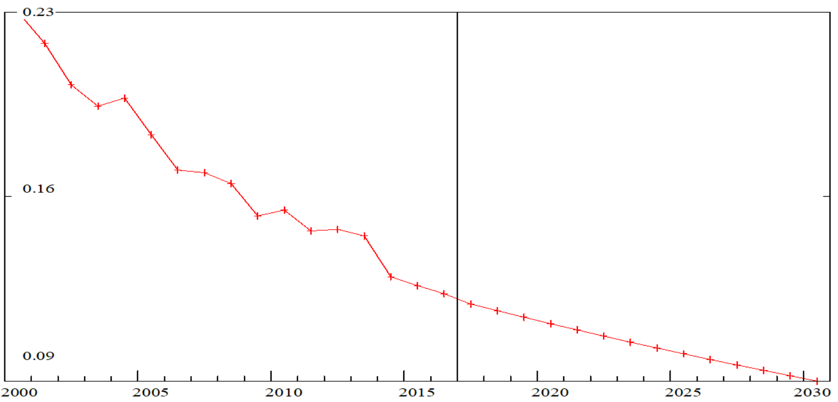
Composite materials vs. Ferrous Metals
From “Chemicals” to “Automobiles and equipment”
From “Ferrous metals” to “Automobiles and equipment”

Slide 17
Partly autonomous driving and saloon comfort rise
4.

Slide 18
Partly autonomous driving and saloon comfort rise
 | Electric equipment | Telecommunication equipment | Machinery | Automobiles equipment
Electric equipment
Telecommunication equipment
Machinery
Automobiles equipment

Slide 19
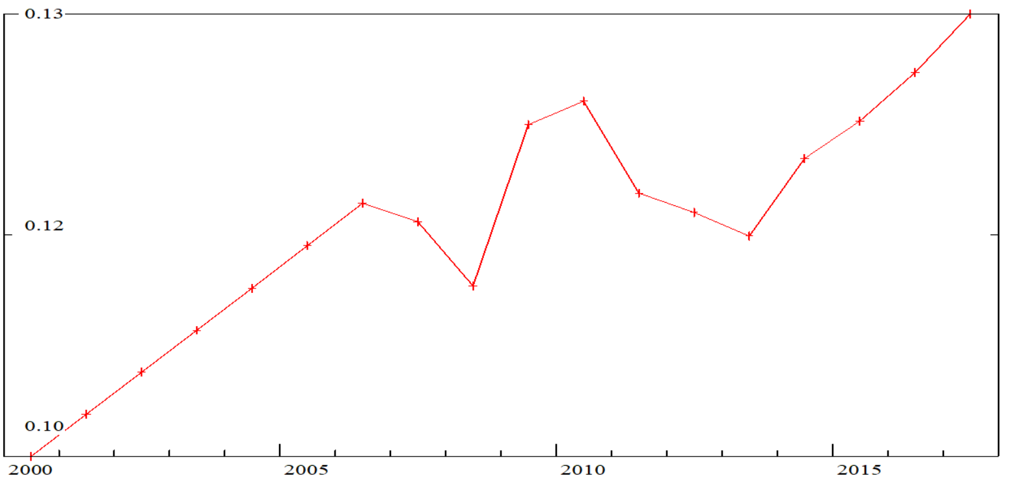
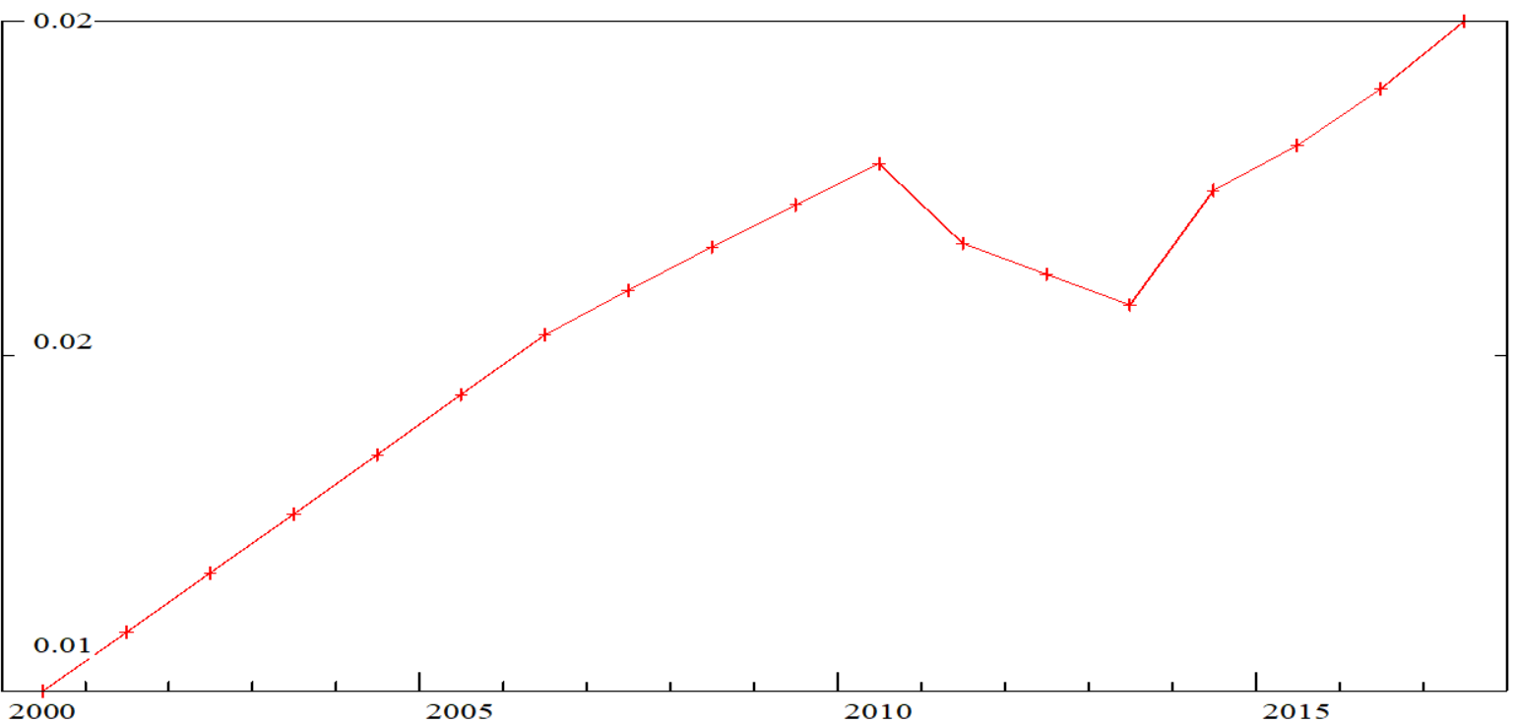
Partly autonomous driving and saloon comfort rise
Electric equipment / Automobile equipment
Telecommunication equipment / Automobile equipment
+22%
+66%

Slide 20
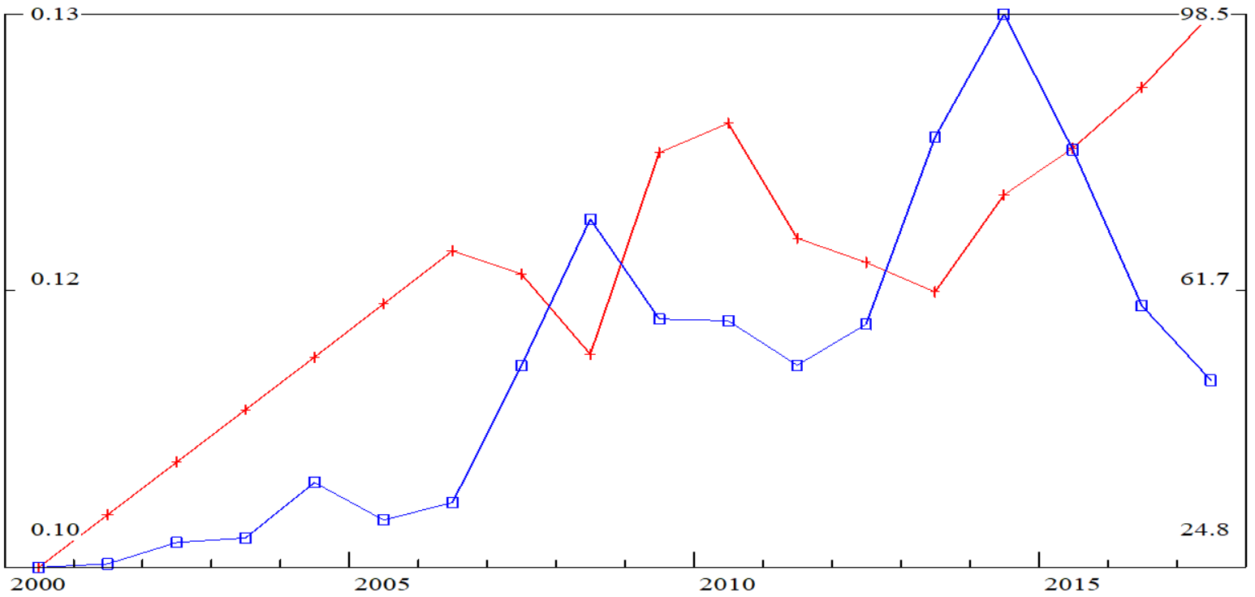
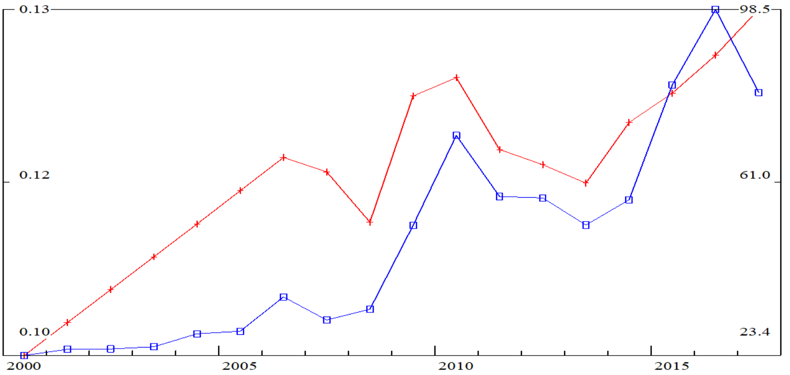
Partly autonomous driving and saloon comfort rise
From “Electric equipment” to “Automobiles & equipment “/ From “Automobiles & equipment” to “Automobiles & equipment “
Relation (red line, left axis)
Investments (blue line, right axis)
Relation (red line, left axis)
Investments with 2 years lag (blue line, right axis)

Slide 21
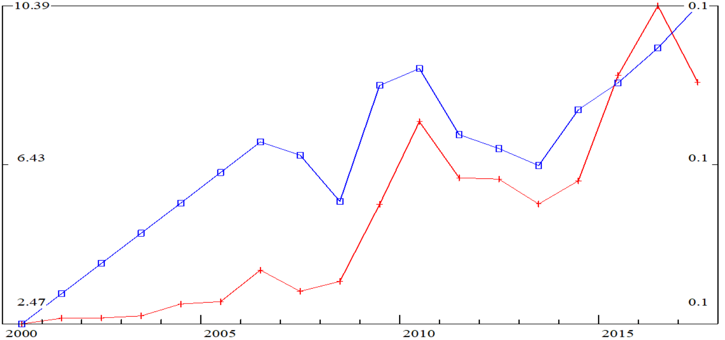
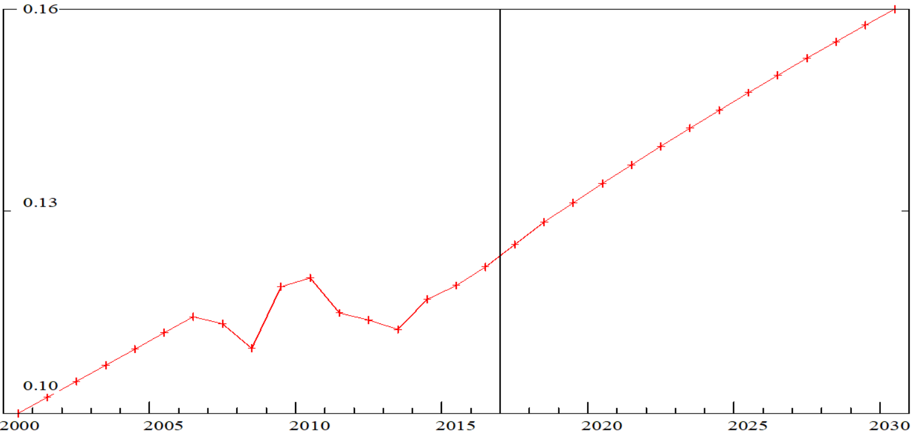
Partly autonomous driving and saloon comfort rise
From “Electric equipment” to “Automobiles & equipment“/ From “Automobiles & equipment” to “Automobiles & equipment“
Predicted (red line, left axis)
Actual (blue line, right axis)
+25% 2030/2017

Slide 22
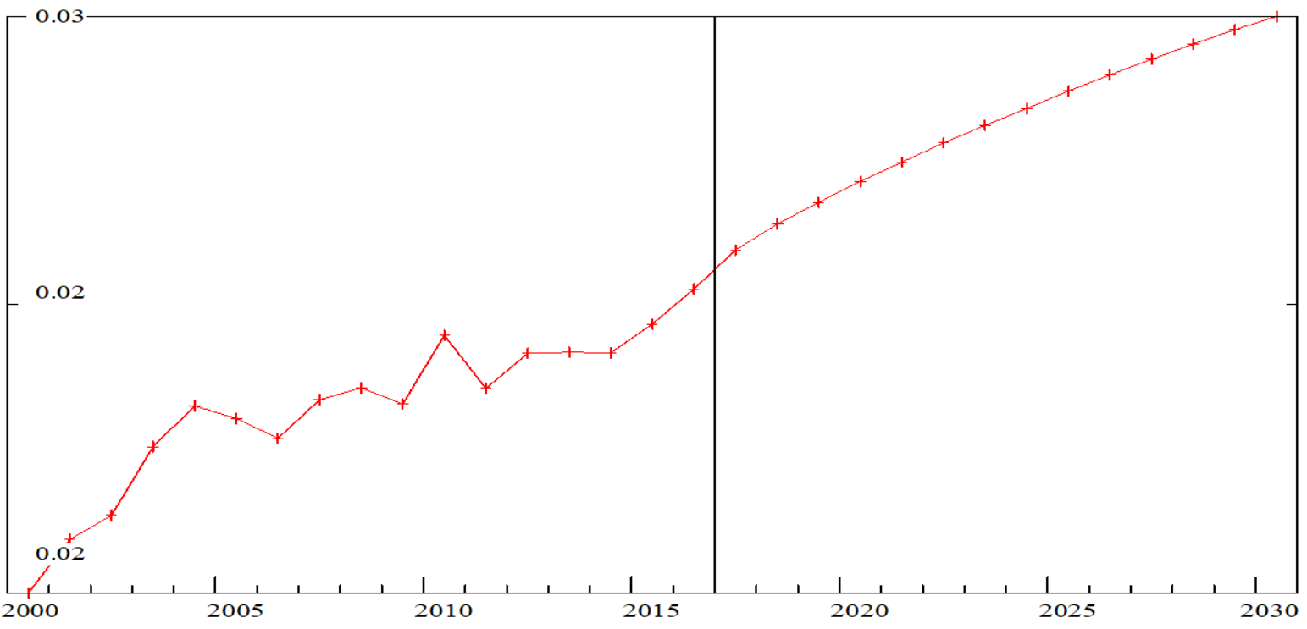
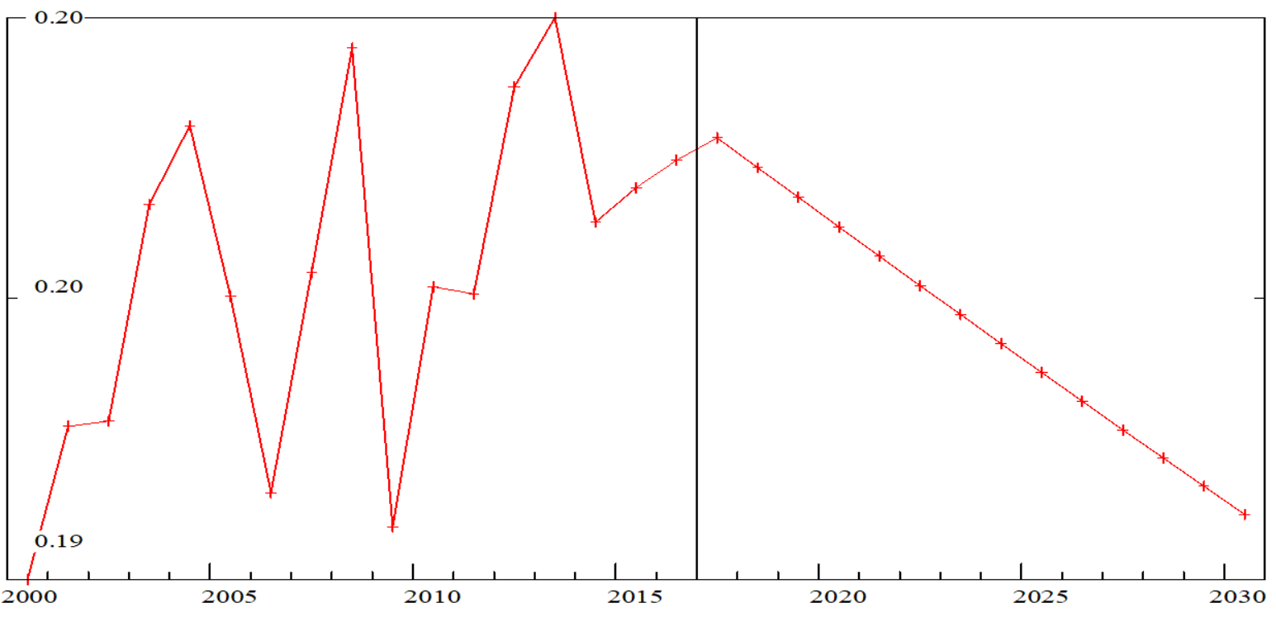
Partly autonomous driving and saloon comfort rise
From “Electric equipment” to “Automobiles & equipment“
From “Automobile equipment” to “Automobiles & equipment“

Slide 23
Digitalization and services share growth
5.

Slide 24
Digitalization and services share growth
 | ICT | Services | Trade | Transport
ICT
Services
Trade
Transport

Slide 25
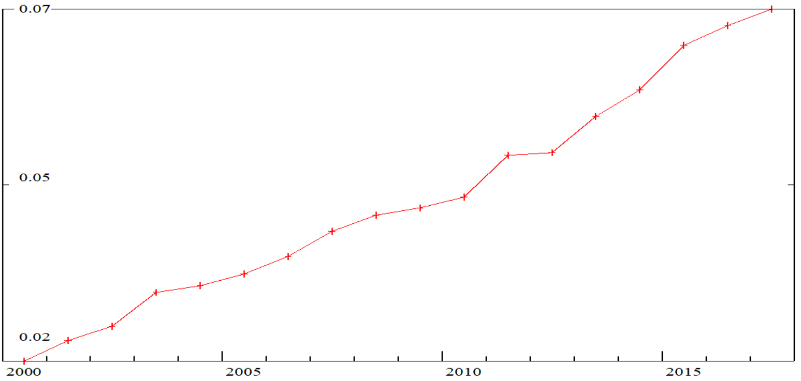
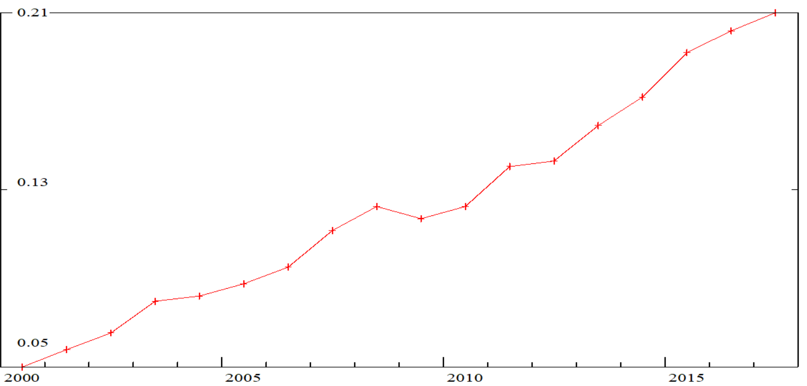
Digitalization and services share growth
ICT / Trade
ICT / Transport
+248%
+346%

Slide 26
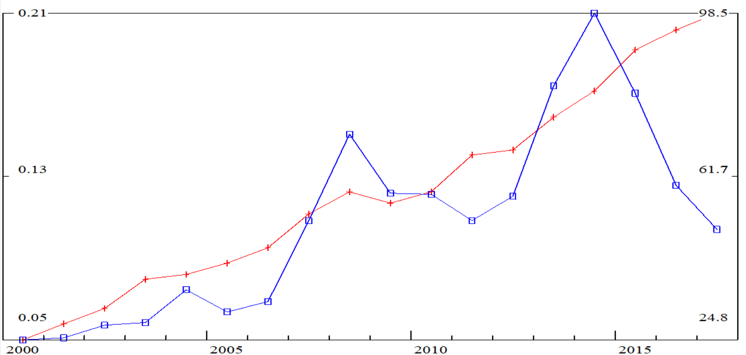
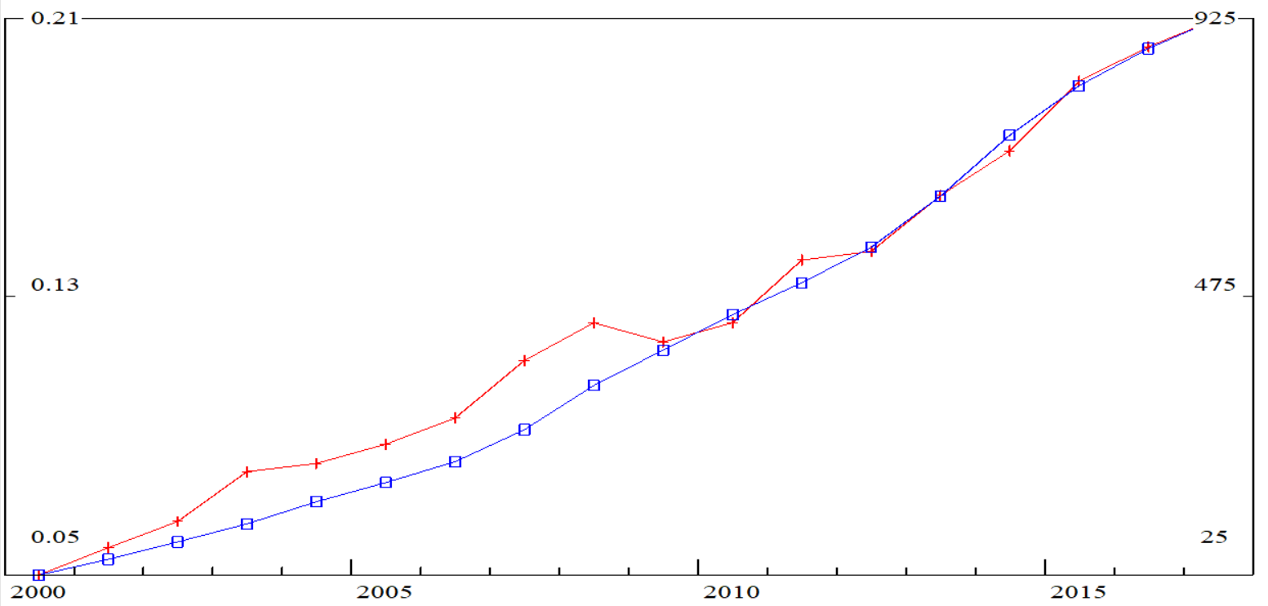
Digitalization and services share growth
From “ICT” to “Automobiles & equipment “/ From “Transport” to “Automobiles & equipment “
Relation (red line, left axis)
Investments (blue line, right axis)
Relation (red line, left axis)
Accumulated investments since 2000 with zero retirement (blue line, right axis)

Slide 27
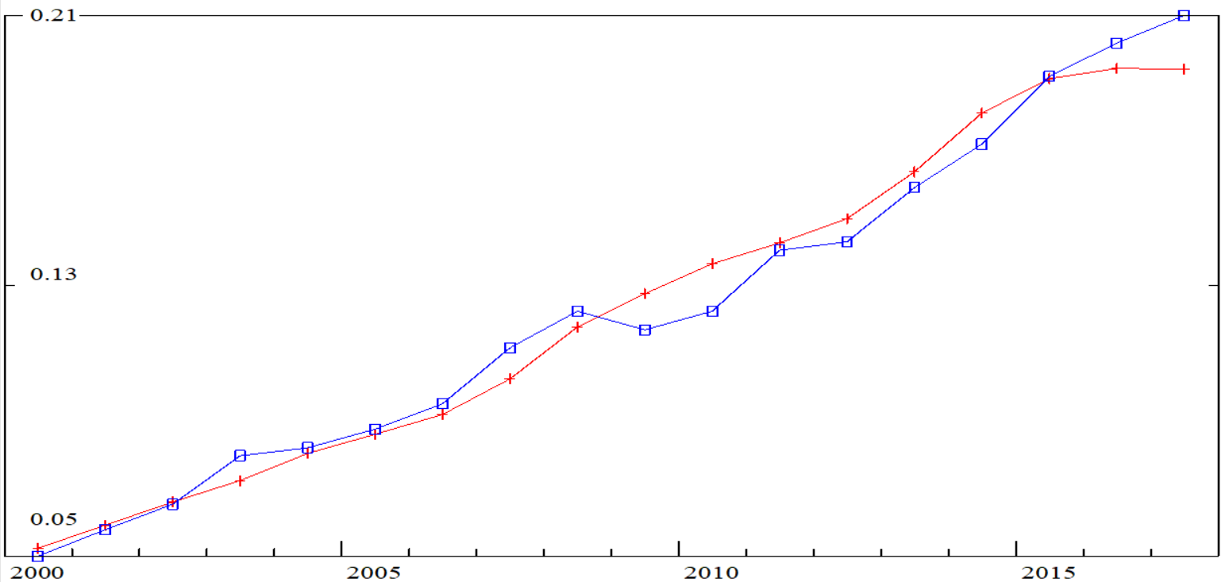
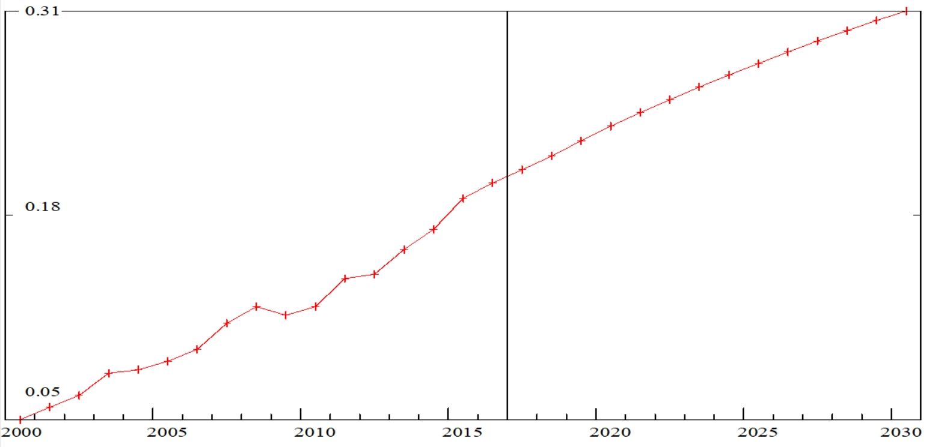
Digitalization and services share growth
Predicted (red line, left axis)
Actual(blue line, right axis)
+49% 2030/2017

Slide 28
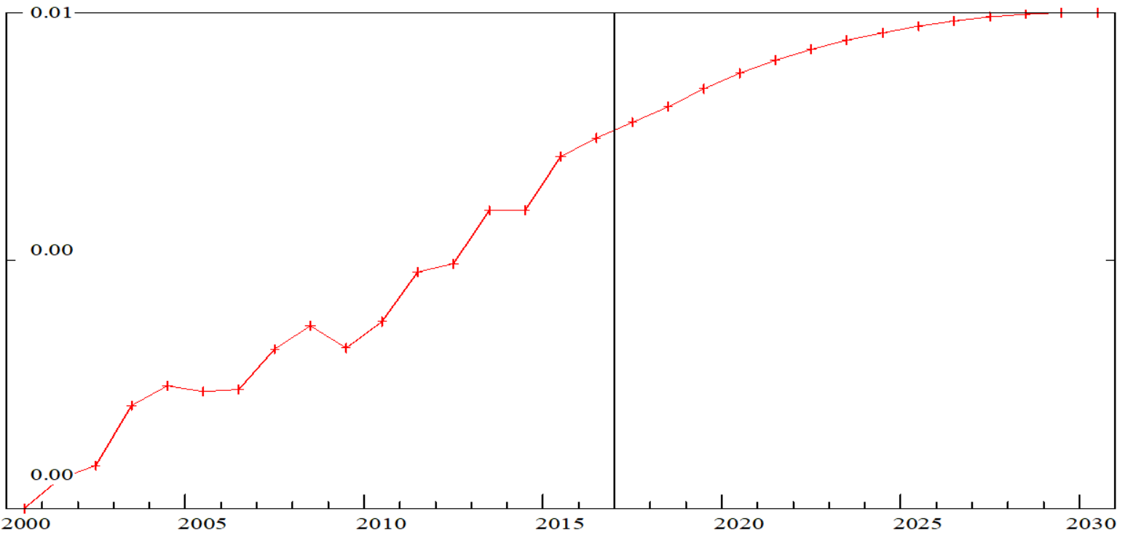
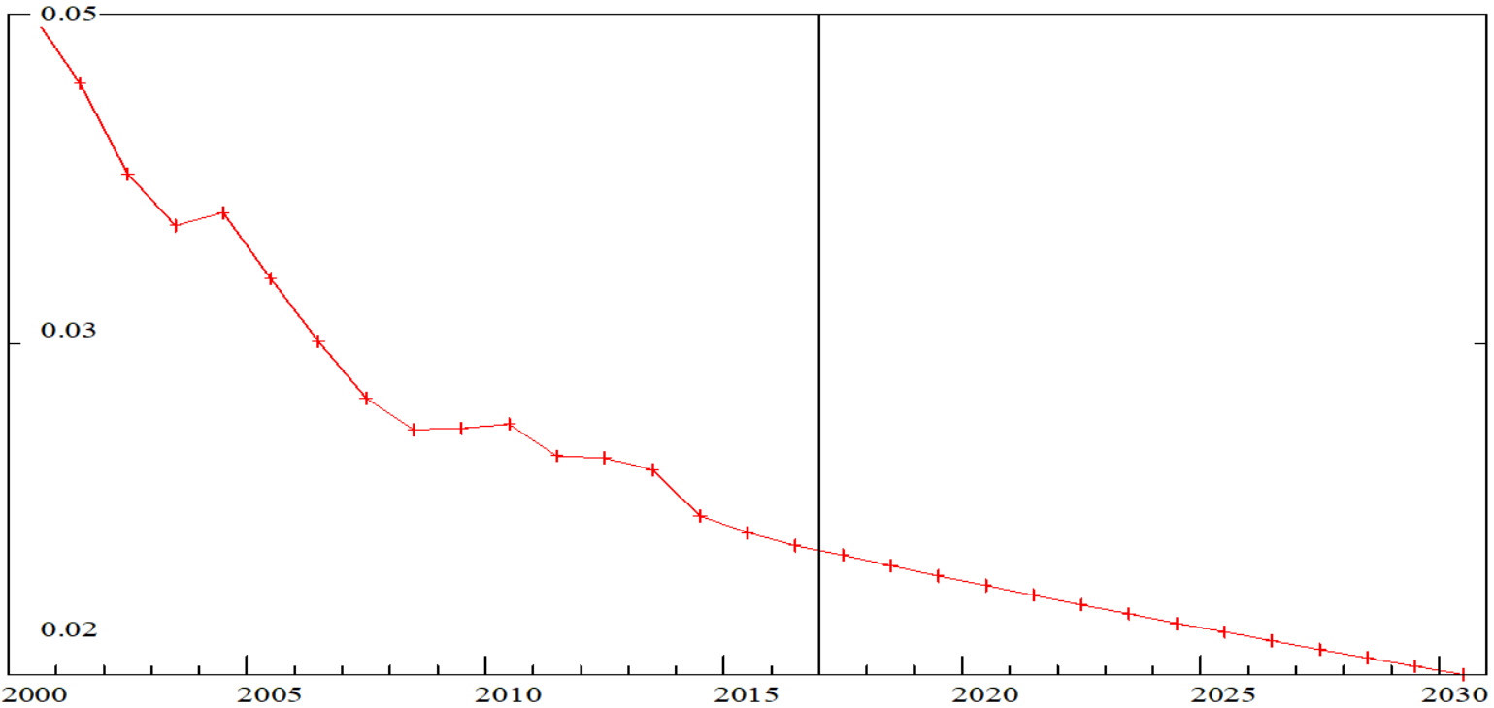
Digitalization and services share growth
From “ICT” to “Automobiles & equipment “
From “Transport” to “Automobiles & equipment “

Slide 29
Effects and conclusion
6.

Slide 30
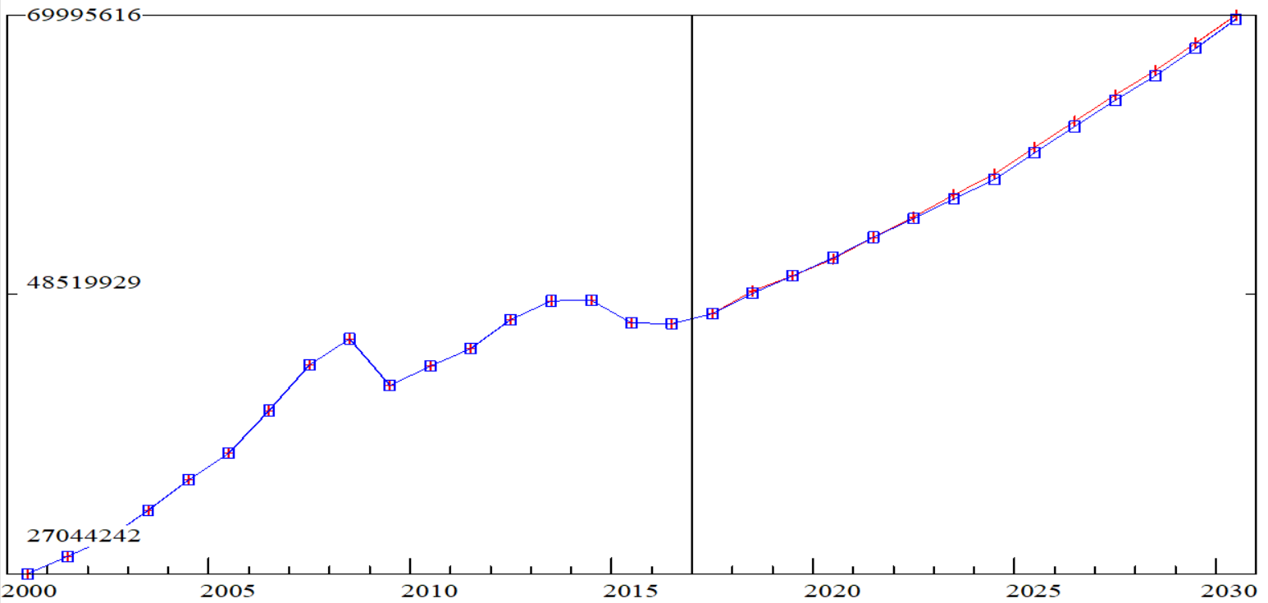
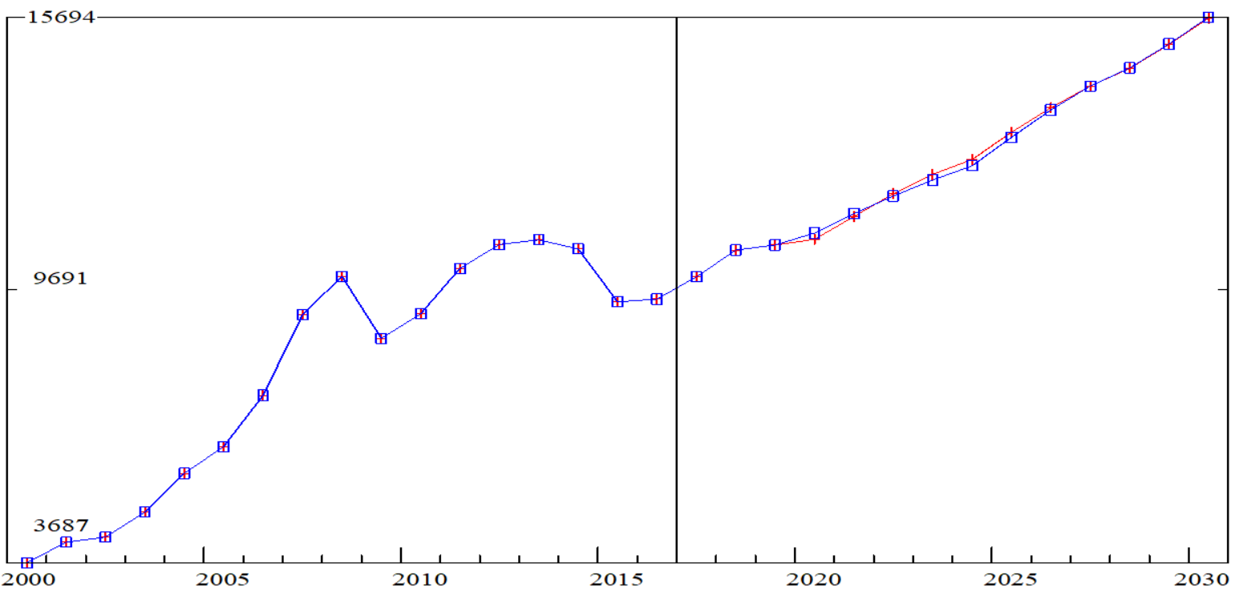
Macro (constant 2010 prices, mln. rub) New (red line) Old (blue line)
GDP
Investments

Slide 31
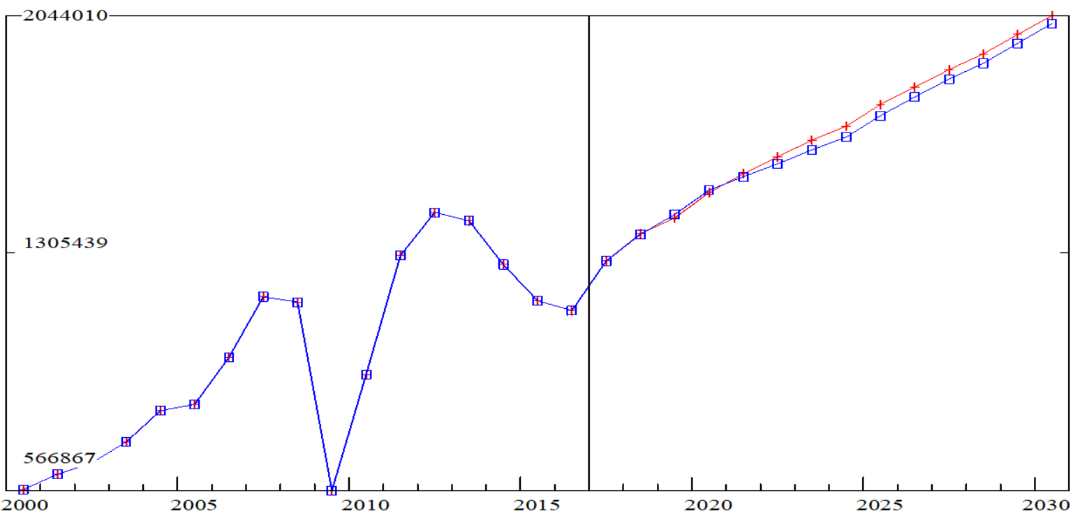
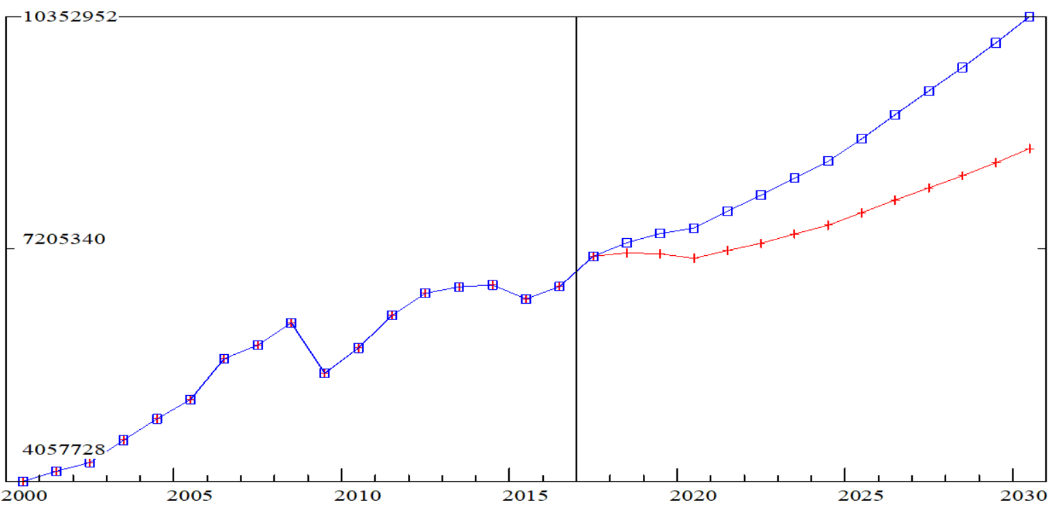
Macro (constant 2010 prices, mln.rub) New (red line) Old (blue line)
Output in Automobiles
Output in Transport

Slide 32
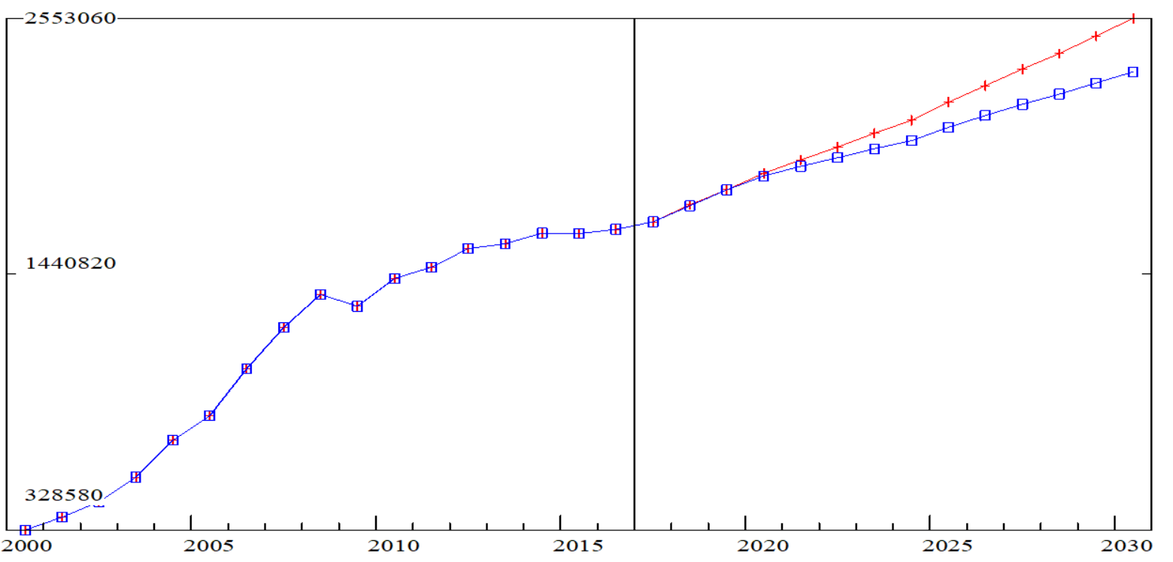
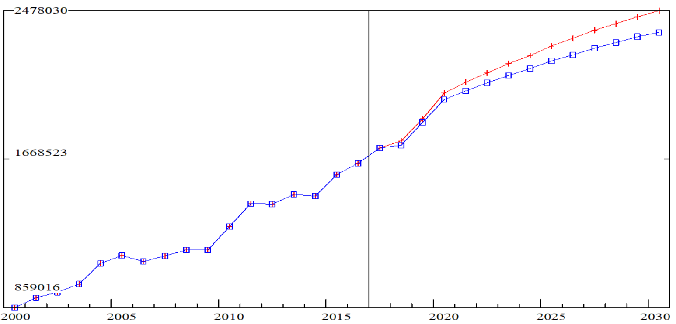
Macro (constant 2010 prices, mln.rub) New (red line) Old (blue line)
Output in ICT
Output in Chemicals

Slide 33
Conclusions and future plans
Technological shifts are to be divided in two groups: existed and expected
Relation of IOCs might be a reflection of technological shift
There was underlined four main blocks of technological shifts in automotive industry
Possible shifts were modeled with RIM
Technological shifts might significantly influence industries’ outputs
Effect for macroparameters is insignificant in this assessment
To develop approach with scenario approach: how cost structure can change within inertia
To multiply this approach to other industries

Slide 34
Contacts
www.ecfor.ru / milyakin
milyakinsergei@gmail.com

